Slide 1
SESRI
Policy & Program Evaluation Workshop
Doha, Qatar
May 29 – June 1, 2016

Slide 2
Organization of the Workshop
Lecture sessions, two per day
  Will run from 8:30 to 11:30 with a short break and then again from 12:15 to 1:30
  Occasional group work
iClicker exercises
Introduction to Stata
Data analysis activities

Slide 3
Outline: Session 1
Workshop objectives
Introductions
Creating public programs to address public problems
Defining program goals (outcomes), targets, instruments (inputs), and results (outputs)
Using program models to define a theory of action
Notes:
What kinds of resources and assistance to seek and where; we will give you vocabulary to be able to discuss issues around program evaluation.

Slide 4
By the end of this workshop, you should be able to:
Understand the purpose of evaluation in public policy
Identify the primary components of policy and program evaluation
Appreciate different ways of evaluating policies and programs
Understand key concepts related to quantitative data analysis
Manage and analyse quantitative data used to evaluate public policy, with an emphasis on SESRI survey data

Slide 5
Who are we?
Michael Traugott (Mike)
Yioryos Nardis
Catherine Nasrallah
Haneen B. Al-Qassass

Slide 6
What constitutes a public policy problem?
A problem affecting some segment of society that government action could (but may or may not) address
Potential government actions include proclamations, decrees, informal policy, lack of policy ("non-policy")
Example of climate change in Doha:
  Officials cannot solve changing weather patterns, which is the root of the problem
  However, officials can address the problems that arise as a result (e.g., flooding)

Slide 7
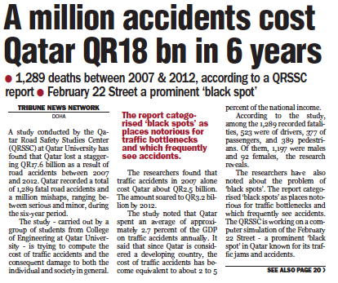
Traffic in Qatar
Qatar Tribune
April 8, 2014
Notes:
Turn to your neighbor and discuss: Whose problem is this? A problem of individual drivers? Of people in accidents? A problem for truckers? For the businesses along February 22nd St? What makes it a public problem?

Slide 8

Traffic in Qatar
Doha News
January 20, 2016
Notes:
Turn to your neighbor and discuss: Whose problem is this? A problem of individual drivers? Of people in accidents? A problem for truckers? For the businesses along February 22nd St? What makes it a public problem?

Slide 9
What makes a problem “public”?
Public goods
Societal needs
Public perception
Political pressure
Concerns about values
Others?
Notes:
Which of these did you discuss in your groups?
Remind individuals that public perception, like popular opinion, is an internal pressure; political pressure can be external (e.g., the EU and immigration)

Slide 10
What is a program?
Set of activities designed to solve a public problem
Involves a set of instruments (inputs) used to achieve a policy goal (outcomes)
Bounded by time, scope or population
Notes:
Note: goals and targets are not always embedded in programs – sometimes only determined post-hoc, for the purposes of evaluation

Slide 11
Programs require . . .
GOALS
  What the policy hopes to achieve
TARGETS
  People or organizations slated for change
INSTRUMENTS/INPUTS/INTERVENTIONS
  Mechanism by which change happens
OUTPUTS
  Change that is slated to occur
Notes:
Goals: What the policy hopes to achieve (could be stated explicitly or not; can have multiple goals which may be competing)
Targets: People and organizations slated for change in the policy design.
Input: Mechanism by which change will happen. Examples include threat, sanctions, incentives, capacity building, etc.
Output: Change in behavior or outcome
Discuss relationship between goals, targets, inputs, and outputs – inputs and targets should be part of program design; goals and outputs are part of program theory
Note: one program might accommodate different goals/outputs even with same inputs and targets – different stakeholders may have different opinions

Slide 12
Goals
  What does the policy hope to achieve?
  Are there multiple goals?
  What are the tensions among them?
  What are the assumptions inherent in these goals?

Slide 13
Clicker Question 1
A program that addresses traffic congestion in Doha should … (Click what you think THE GOVERNMENT’S goal is. )
Reduce the number of traffic accidents, in order to improve the health and lower the mortality rate.
Reduce air pollution, caused by idling vehicles and under-utilization of carpools and mass transit.
Reduce travel times, in order to increase business productivity and quality of life.
All of the above.
Notes:
GOAL OF THIS SLIDE: SHOW THAT LOTS OF DIFFERENT TYPES OF PROGRAMS CAN ADDRESS MULTIPLE DIMENSIONS OF ONE PUBLIC POLICY PROBLEM (i.e., traffic as a public health concern; as an environmental concern; as an economic concern; as a quality of life concern.)
If program didn’t start out with clear goals, then evaluators have to decide what goals, targets, inputs, outputs to evaluate: may be difficult to determine from design of program, and will be politically sensitive because some outputs will make program look better than others.
Also, notice that if you haven’t planned an evaluation before the program started, some data won’t be available; programs often end up being evaluated not on the original goal, but on the outcome that’s easiest to measure - Can point out that the newspaper article puts it in economic terms.
Finally, notice that some goals may compete with each other. Reducing travel times and reducing air pollution need not be consistent. Reducing traffic accidents may have nothing to do with either pollution or travel time.

Slide 14
Clicker Question 1 (again)
A program that addresses traffic congestion in Doha should… (Click the ONE that YOU think should be the goal.)
Reduce the number of traffic accidents, in order to improve the health and lower the mortality rate.
Reduce air pollution, caused by idling vehicles and under-utilization of carpools and mass transit.
Reduce travel times, in order to increase business productivity and quality of life.
All of the above.
Notes:
Which goal does the class choose? How might a policy that tries to achieve all of these goals fail to achieve any?
What’s the right measure for each goal? How might a policy that fails to measure each goal not be able to show success?
What are some output measures that might not be related to achieving these goals?
What are some ways that the government might choose to measure success that have nothing to do with outcomes? (inputs)

Slide 15
Targets
  Which individuals or groups is the policy designed to affect?
  Who are the recipients of the program?
  How are they chosen?
  Who delivers the program?

Slide 16
Exercise
Turn to your neighbor. Who are the right target(s) for a program with the goal that we chose in the previous clicker question?
  Possibilities:
  Drivers: Commuters, commercial drivers, reckless drivers
  Businesses: Mass transit operators, companies with workers who can telecommute, companies who get deliveries
  Service providers: Driving instructors, schools

Slide 17
Inputs
Also called program instruments, program interventions, program treatments
Can be rules, education, incentives, sanctions, opportunities, infrastructure
Must be linked to outputs

Slide 18
Exercise
Turn to your neighbor. Propose an input to reduce traffic congestion that would be appropriate for the following targets:
  Bad drivers
  Owners of businesses with workers who could telecommute (who could work from home)
  People living in residential neighborhoods located near major traffic routes

Slide 19
Outputs
Also called program results, impacts or outcomes
Must be subject to CHANGE and ASSESSMENT
Can be anticipated or unanticipated
Different from program outcomes or goals:
  The evaluator should choose outputs that have the closest connection possible to the program inputs.
  Outputs indicate outcomes, but are not equal to them; evaluators should be skeptical of the output-outcome relationship.

Slide 20
Clicker Question 2
  Which of these pairs connects an input with an appropriate output?
Fining drivers who cause accidents -> more money collected in fines
Fining drivers who cause accidents -> fewer accidents
Fining drivers who cause accidents - > fewer traffic jams
All of the above.

Slide 21
The Simple Program Model
Problem
  Traffic in Doha is badly congested
  Goal
  Reduce traffic congestion in Doha
Targets
  Passenger car drivers
  Trucks
  Taxis
  Buses
Instruments
  Odd/even license plates for passenger cars
Output
  Fewer passenger cars on the road
  Outcomes
  Smoother traffic flow
  Fast commuting
  Fewer accidents
  Less fuel consumption
What is the causal story? (What “causes” congestion?)
Notes:
Traffic congestion is caused by too many cars.
Method used in Beijing during the 2008 Summer Olympics

Slide 22
The Importance of Assumptions
Includes the beliefs we have about the program, its participants, or how it might work
May or may not be stated explicitly (but should be)
Typically not tested
Program models can help make these assumptions explicit, but not always
Evaluator must be aware of what assumptions are inherent in the program model
Example: Drivers will only go on the road on their designated days

Slide 23
Assumptions can be about…
Program staff – knowledge, skills, will
Available resources
Target motivation and behavioral patterns
Causal links between elements of the program model
External environment
Extant knowledge base

Slide 24
Clicker Question 3
What other assumptions are embedded in the odd/even driving rule?
Congestion is due to too many cars on the roads, rather than to inefficient road design.
Drivers have only one car per driver.
Drivers are unable to get waivers from the odd/even rule.
Drivers will not take advantage of newly empty streets to idle or park their cars illegally.
Notes:
Perhaps ask questions after having them discuss what some of the assumptions might be.
Assumptions should all be embedded or ignored by the program. C) Drivers change their habits and more places get congested. Clickers don’t let you click all that apply. Waivers instead of exceptions.

Slide 26
SESRI
Policy & Program Evaluation Workshop
Doha, Qatar
May 29 – June 1, 2016

Slide 27
Outline: Session 2
Approaches to analyzing/ evaluating public policies
  Impact/Outcome Evaluation
  Process Evaluation
Generating hypotheses
Testing hypotheses with data
Activity #1: Introduction to Stata and testing hypotheses with data

Slide 28
Impact Evaluation
What are the effects of the program?
  Did the program have the intended effects?
  Did it have other (unintended) effects?
  How do we know it was the program, and not some other factor, that caused the observed outcome(s)?

Slide 29
Correlation vs. Causation
The ability to draw causal conclusions requires more than an observed correlation between two (or more) variables.
  Correlation: statistical technique that shows whether and how strongly pairs of variables are related.
    Example: height and weight are correlated; taller people tend to be heavier than shorter people. The relationship isn't perfect.
    Correlation can tell you just how much of the variation in peoples' weights is related to their heights.
  Causation: capacity of one variable to influence another. The first variable may bring the second into existence or may cause the incidence of the second variable to fluctuate.
    Example: smoking causes lung cancer
    Probabilistic vs. deterministic causation
Notes:
Explain what an INDEPENDENT and DEPENDENT VRIABLE is

Slide 30
Three Criteria for Establishing a Causal Relationship
1. Covariation
  When the values on one variable change, so do values on the other
  Variables CHANGE TOGETHER, they are CO-RELATED
2. Temporal Order
  Changes on the independent variable precede changes on the dependent variable in time. X is the cause of Y and not the reverse.
3. Elimination of rival hypotheses
  Other potential causes are accounted for and ruled out: PLAUSIBLE ALTERNATIVE HYPOTHESES or EXPLANATIONS are eliminated

Slide 31
Counterfactuals
Need to construct a “counterfactual” – what would have happened in the absence of the program, ceteris paribus?
This is impossible to actually observe! However, we can use experiments and other research designs to approximate this counterfactual.
A strong counterfactual can help eliminate alternative explanations of an observed outcome.

Slide 32
Randomized Control Trials (RCTs)
Powerful research design in which the researcher/ evaluator controls assignment of the treatment.
RCTs rely on random assignment to create a compelling counterfactual
  Researcher randomly assigns individuals in a study to two groups:
    Treatment
    Control
  Each individual must have an equal chance of being assigned to either group
This creates groups that are “equal in expectation” even if the individuals are not identical.

Slide 33
Why does random assignment work?
Ensures that the groups are equivalent (at least in expectation of receipt of treatment) prior to being treated or not
  This provides a defensible counterfactual, which then allows us to establish causality
  Creates “all else equal” conditions across two groups
Allows researcher to know and control the selection process correctly
Ensures alternative causes are not confounded with participation in the program

Slide 34
Constructing a counterfactual through quasi-experimental design
Often the evaluator cannot randomly assign treatment
Construct a “control” group that is otherwise similar to the treatment group but that did not receive the treatment.
  Control group is typically identified after the program/treatment is administered.
Research design strategies / Data analysis strategies
Data collection and analysis strategies such as difference-in-difference and matching create a stronger counterfactual comparison.

Slide 35
Impact Evaluation – Road Redesign
What are the options for road redesign?

Slide 36
Process Evaluation
How was the program implemented?
  Often conducted if/when a program does not have the intended impact
  Was the unexpected outcome due to deviations in how the program was implemented?
  Or was the program theory incorrect?

Slide 37
Impact Evaluation – Road Redesign
How were the intersections selected?

Slide 38
Generating hypotheses
Specifies expected relationship between elements of the program that will be tested with data
Differ from assumptions which are not tested, but which are important to clarify when testing hypotheses and evaluating a program
Program evaluators use hypotheses in conjunction with data to test the relationship between elements of program model

Slide 39
Clicker Question 4
Which is a testable hypothesis that may be formulated based on the given program model?
Odd/even driving rules are the best method of reducing traffic congestion.
Limiting drivers to odd/even days will reduce traffic congestion.
Are individuals who comply with the odd/even rule law-abiding?
Traffic congestion in Doha is caused mainly by rude drivers.
Problem
  Traffic in Doha is badly congested
  Goal
  Reduce traffic congestion in Doha
Targets
  Passenger car drivers
  Trucks
  Taxis
  Buses
Instruments
  Odd/even license plates for passenger cars
Output
  Fewer passenger cars on the road
  Outcomes
  Smoother traffic flow
  Fast commuting
  Fewer accidents
  Less fuel consumption

Slide 40
Testing hypotheses with data
Most hypotheses deal with causal relationships that can be observed in the real world
  E.g., a specific program (input) causes a specific outcome (output)
  E.g., changing traffic alignments (input) causes a reduction in traffic accidents (output)
  E.g., variable X causes variable Y
Testing hypotheses requires data
  X: input or independent variable
  Y: output or dependent variable
  Both X and Y must vary and be measured for the same units

Slide 41
Testing a simple hypothesis
Hypothesis: Changing Doha road alignments reduces traffic accidents.
Possible data sources
  X (changing road alignment)
    Program descriptions, i.e. which designs?
    Time (proxy)
    Others?
  Y (traffic accidents)
    Total number of monthly reported accidents
    Counts of accidents at specific locations
    Perceptions of increase or decrease in accidents reported by drivers
    Others?

Slide 42
Testing a simple hypothesis
We are going to use the example of road redesign to go through some examples of alternative data sources to evaluate the same hypothesis:
  H: Changing the design of roads in Qatar will reduce traffic accidents.

Slide 43
Activity #1
Introduction to Stata
Test the hypothesis that changing road design in 2012 reduced traffic accidents using simulated quarterly ministry data.
What would the hypothesis be?
What would appropriate units of analysis be?
What would relevant measurements be?

Slide 44
Stata instructions
In the folder “Datasets and documentation” find the dataset named dataset1_accidents_quarterly.dta
If you double click on it, it will open up in Stata

Slide 45
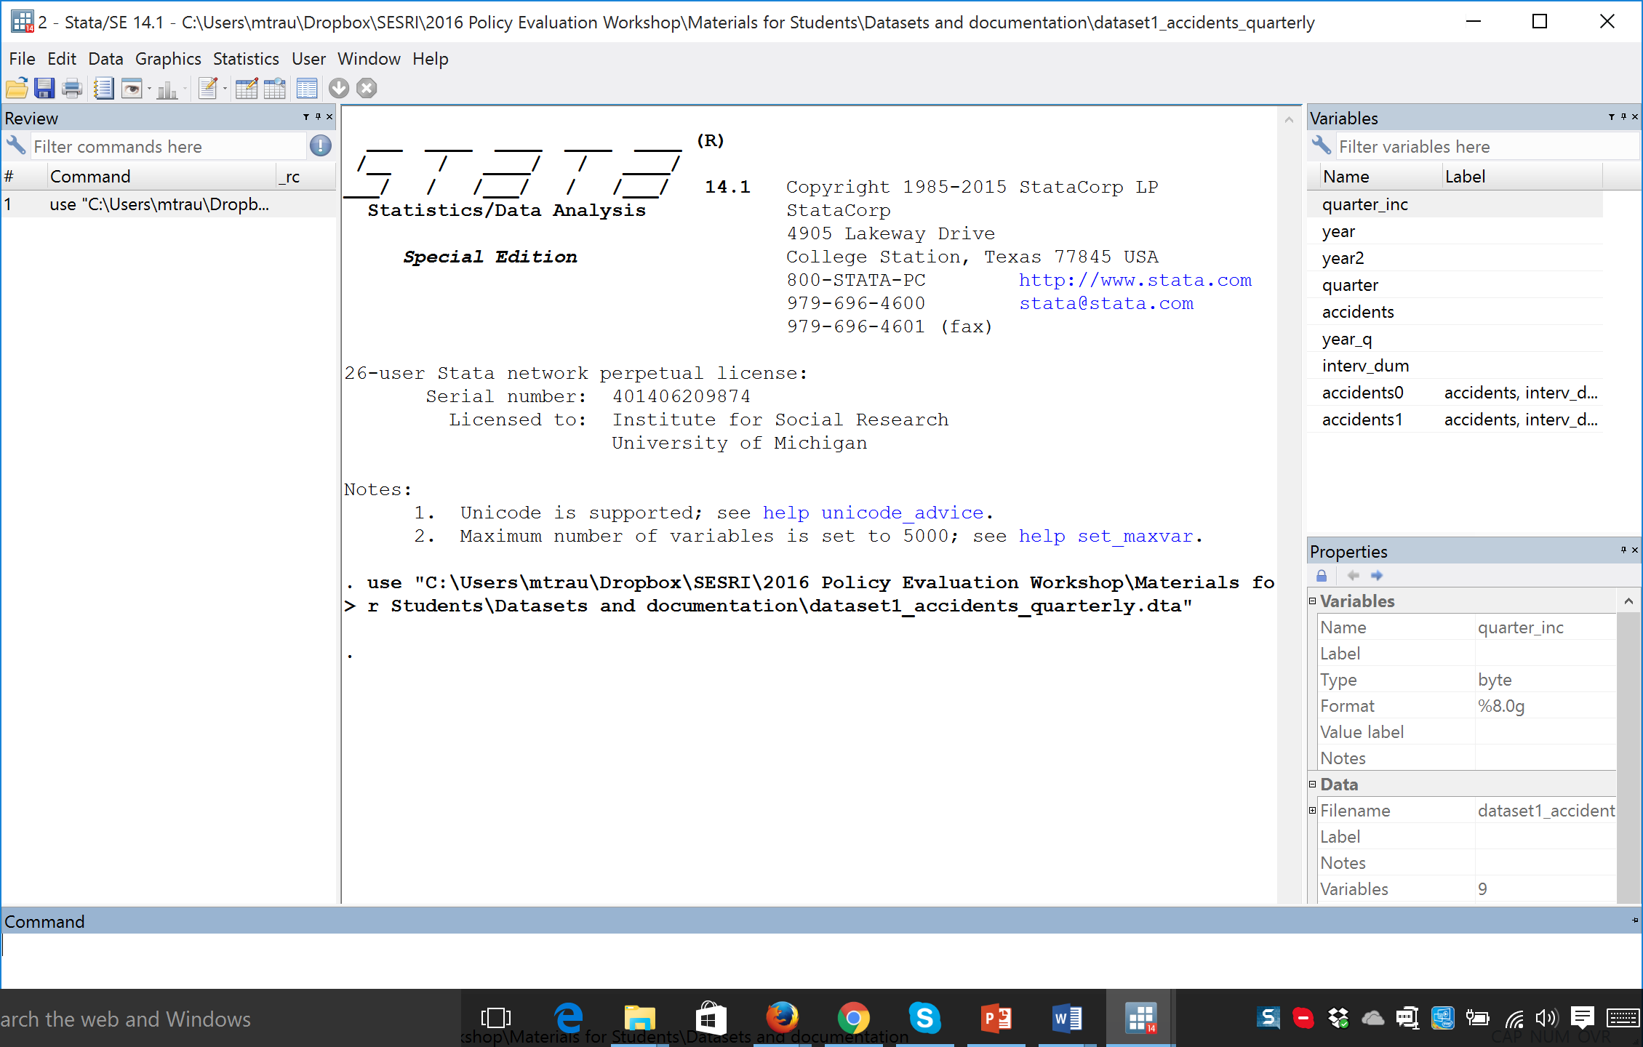
Stata instructions
Notes:
Explain the layout of the Stata screen, including information about the dataset on the right.

Slide 46

Stata instructions

Slide 47
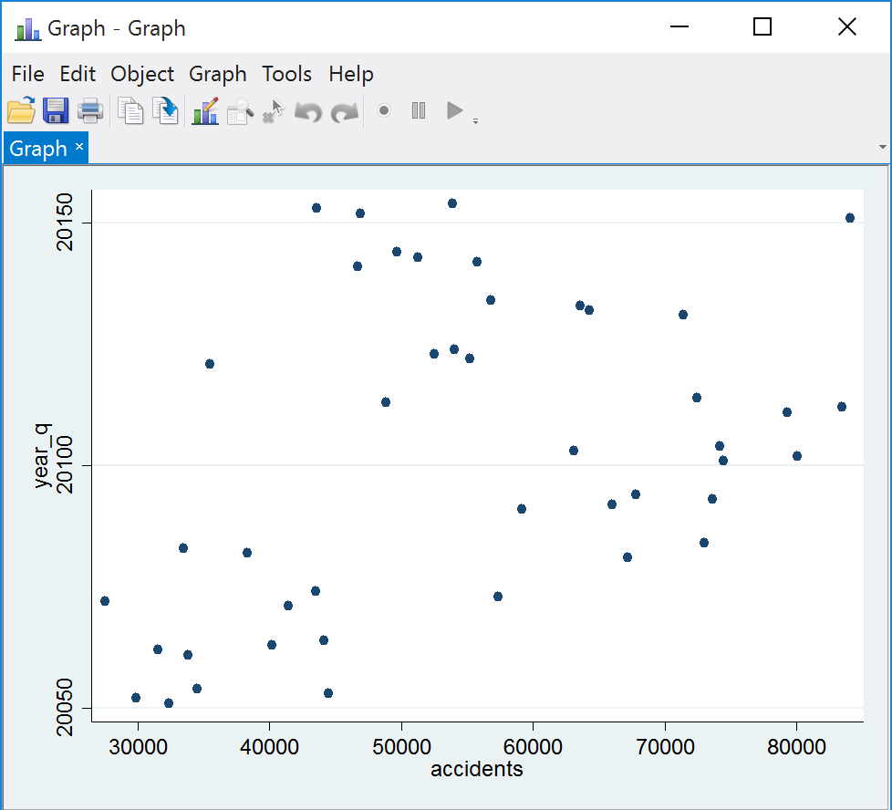
Stata instructions
Notes:
Here the X and Y axes are reversed, somewhat illogically from the instruction in Stata.

Slide 48
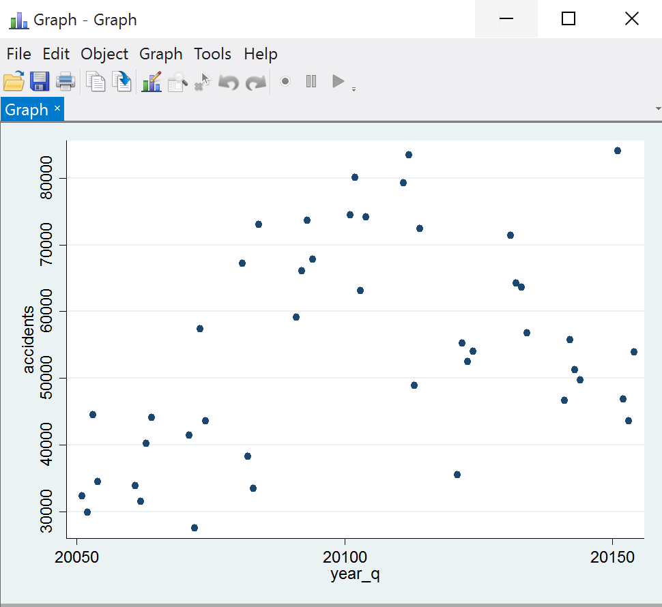
Stata instructions

Slide 49
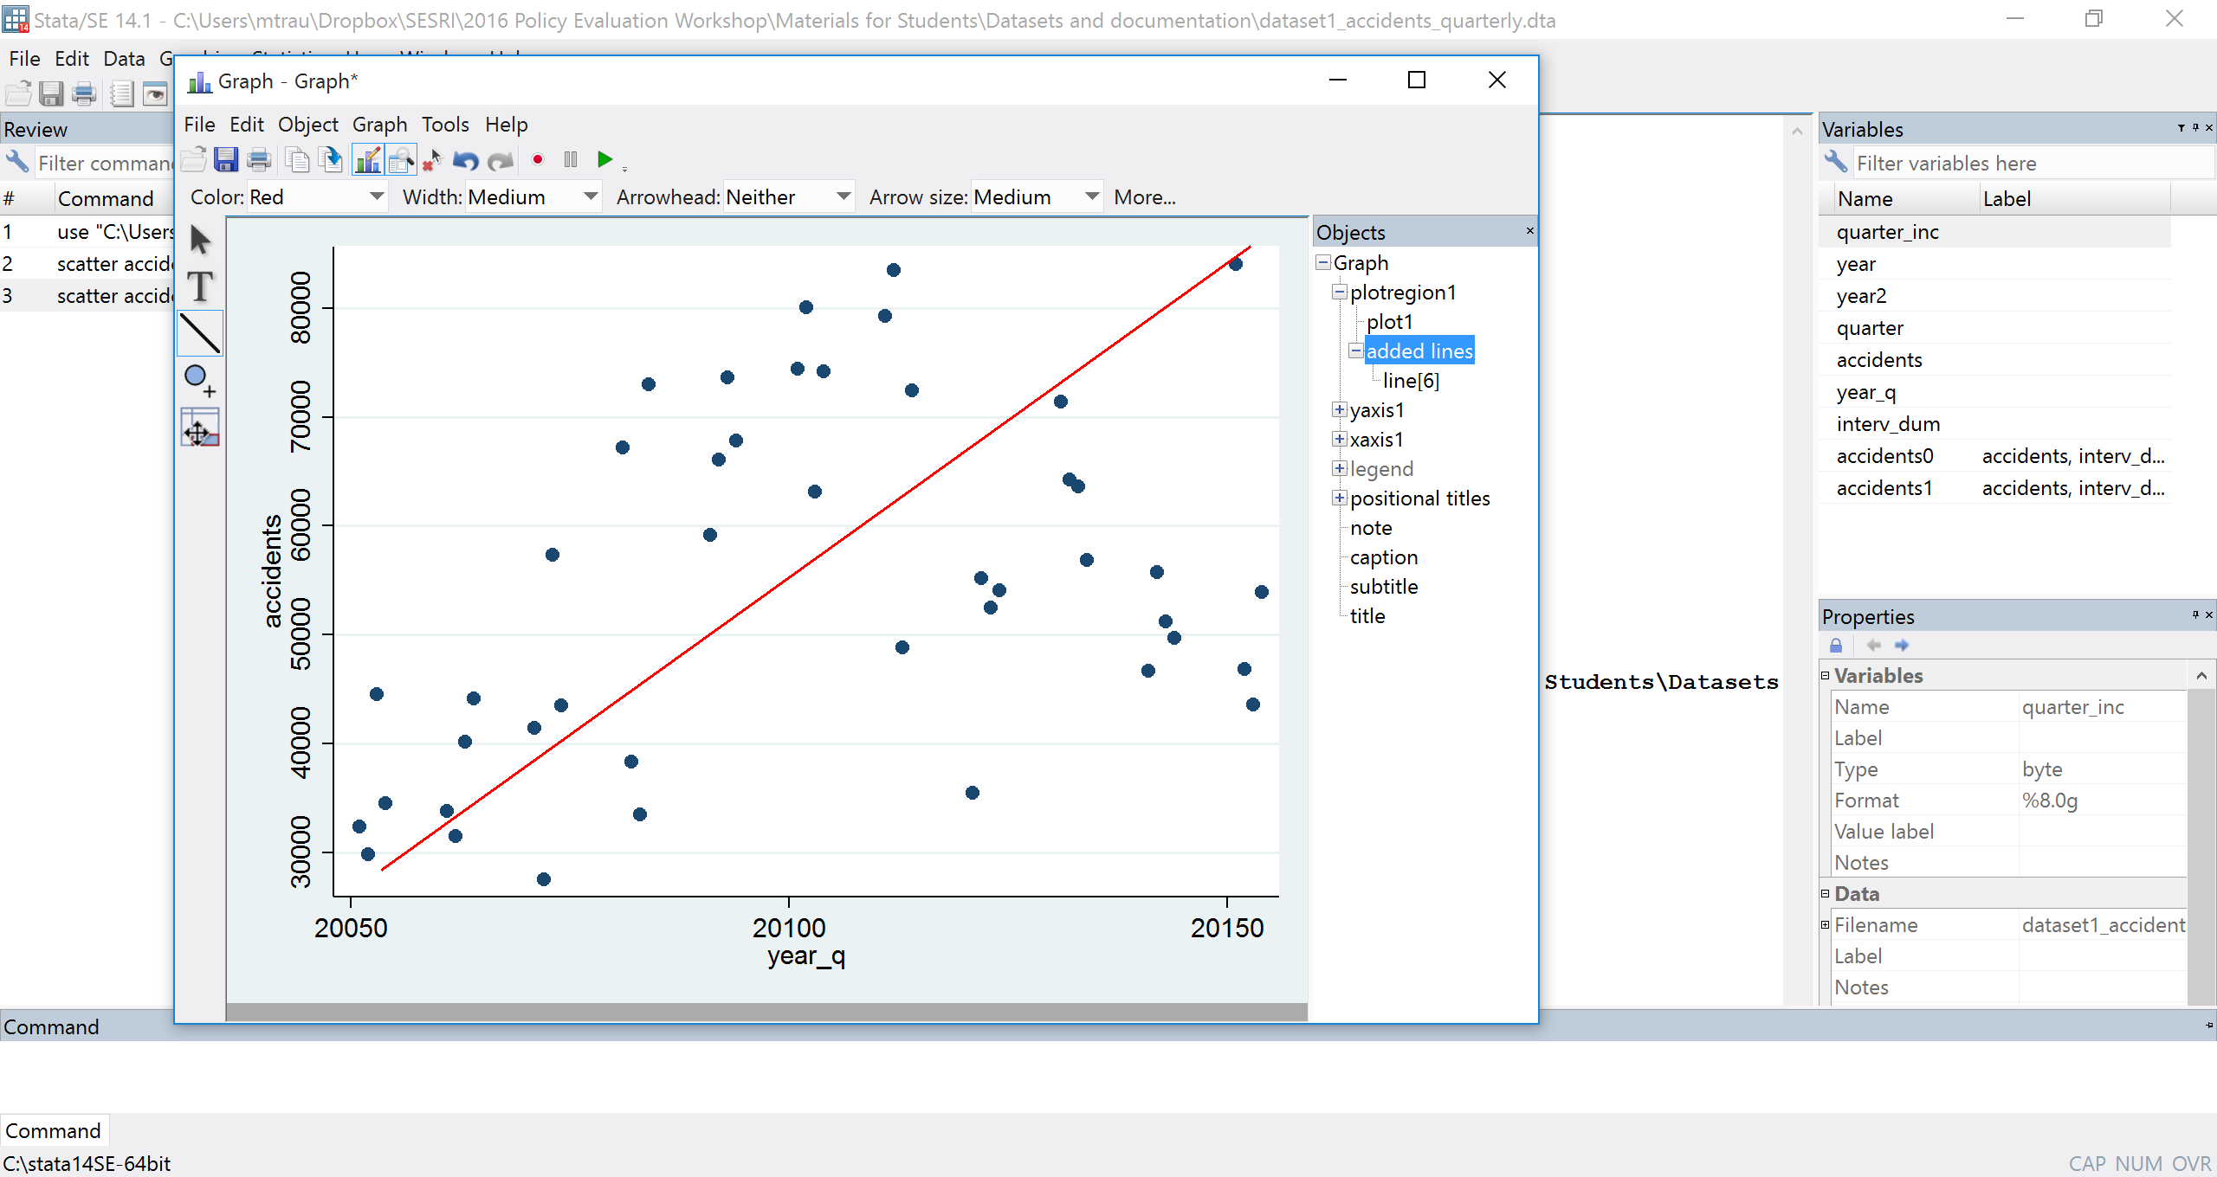
Stata instructions: adding a line

Slide 50
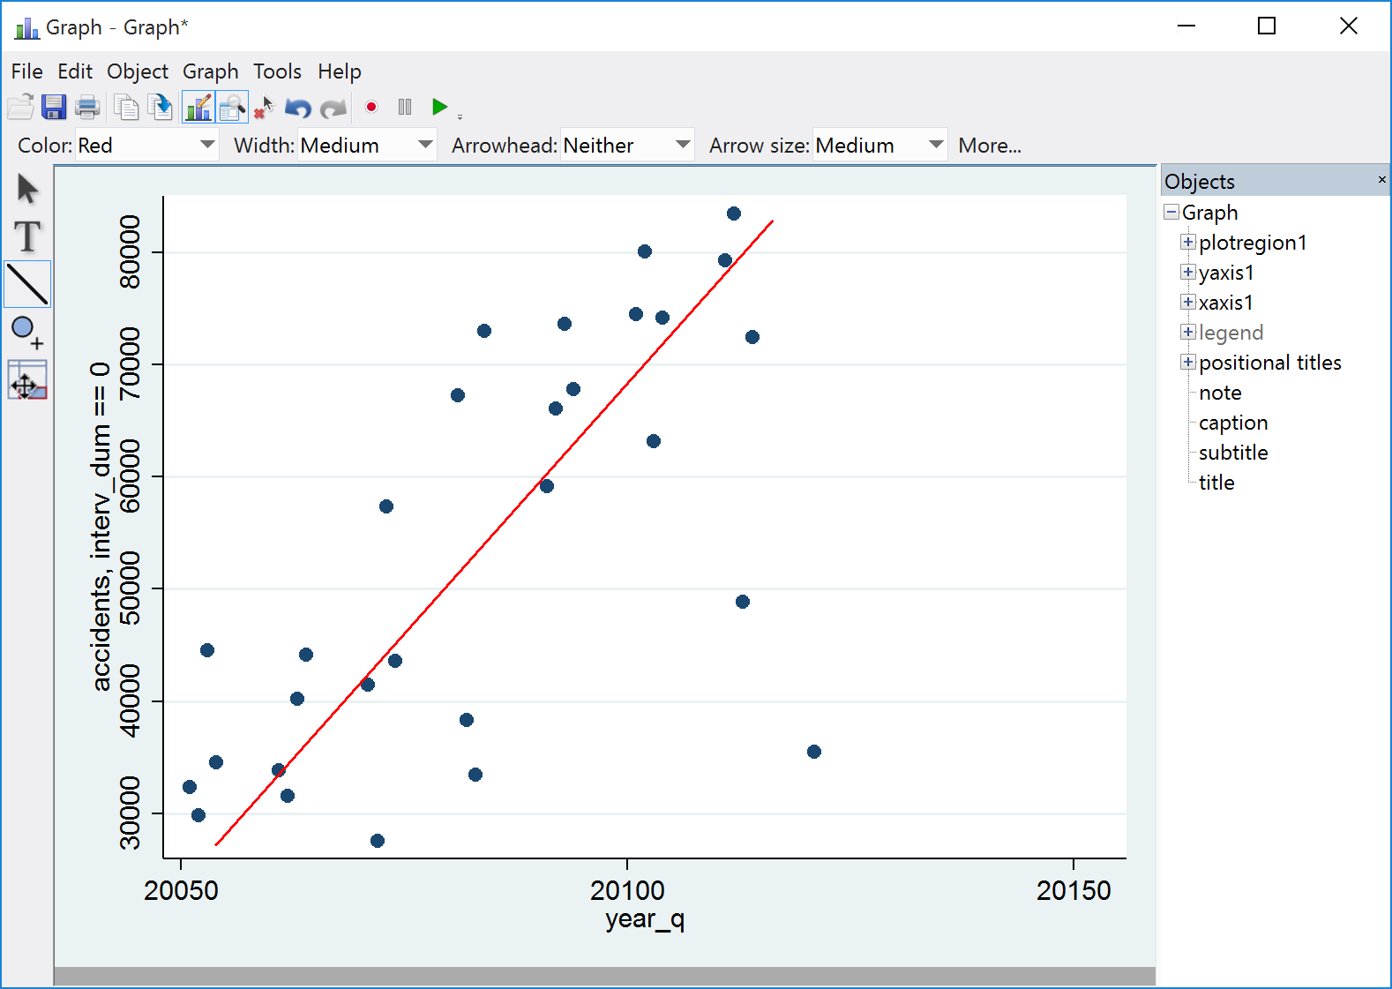
Stata instructions:
Early data with line

Slide 51
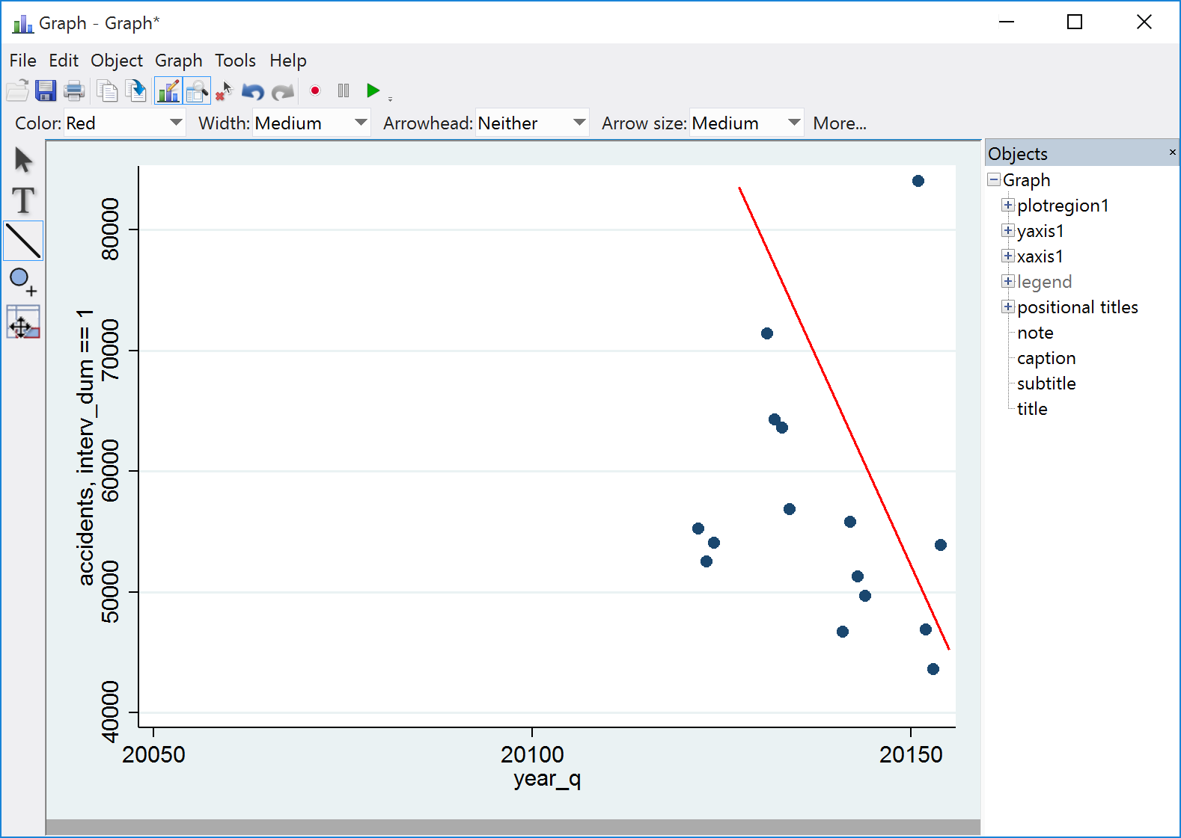
Stata instructions:
Late data with line

Slide 52
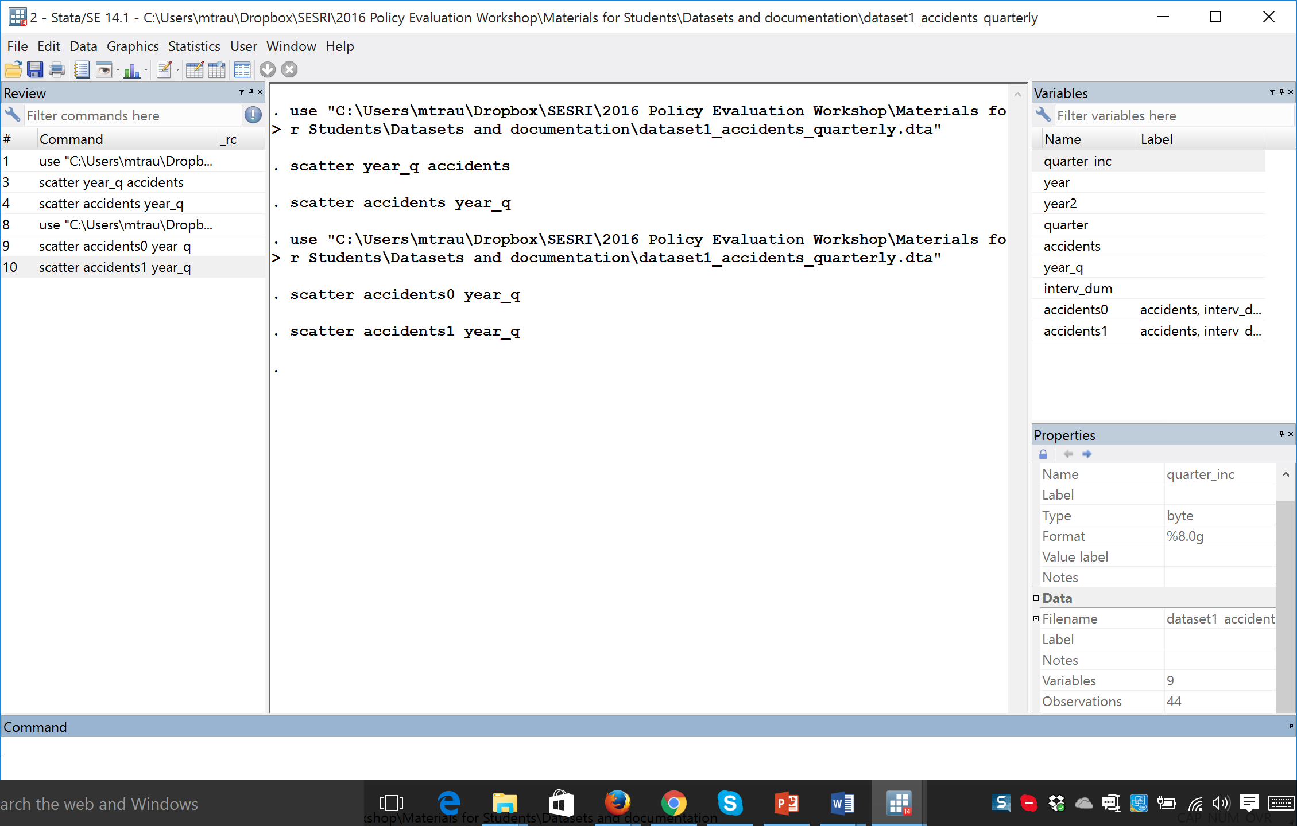
Stata instructions

Slide 53
SESRI
Policy & Program Evaluation Workshop
Doha, Qatar
May 29-June 1, 2016

Slide 54
Outline: Session 3
Data types and sources
Operationalization
Measurement
Reliability and validity
Measurement theory
  Random error
  Bias

Slide 55
What is Data?
Factual information (as measurements or statistics) used as a basis for reasoning, discussion or calculation
Information output by a process that includes both useful and irrelevant or redundant information and must be processed to be meaningful
Information in numerical form that can be digitally transmitted or processed
Source: Merriam-Webster online dictionary

Slide 56
Data Types and Sources
Administrative
Population/census
“Big” data – social media, transactions
Individual – attitudes, behavior

Slide 57
Administrative Data
Statistical data from administrative (typically government) sources.
Examples

Slide 58
An Example of Administrative Data

Slide 59
Population/Census Data
A population census is the total process of collecting, compiling, evaluating, analyzing and publishing or otherwise disseminating demographic, economic and social data pertaining, at a specified time, to all persons in a country or in a well delimited part of a country. (Source: OCED)
Population census or census of traffic intersections

Slide 60
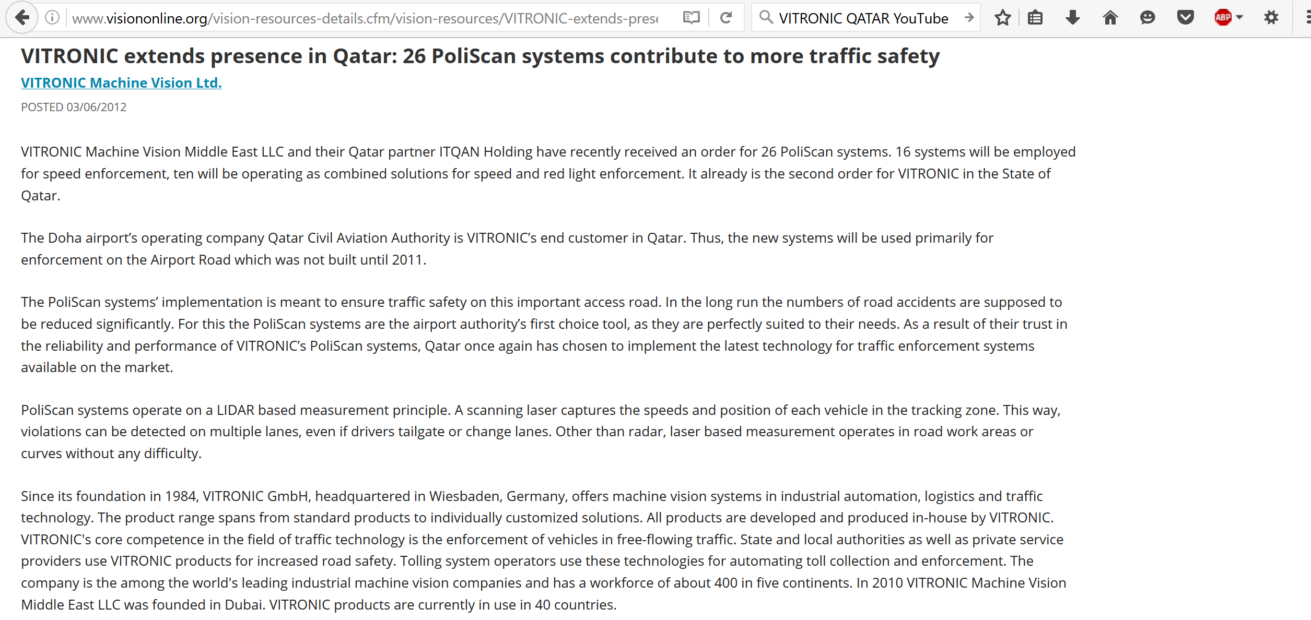
“Big” Data
Data sets that are so large or complex that traditional data processing applications are inadequate
Examples: VITRONIC systems in Qatar

Slide 61
VITRONIC video
https://www.youtube.com/watch?v=_O5368tjcmY

Slide 62
Surveys
Data collected from a sample of individuals in a systematic way
  Sampling
  Data collection modes
Attitudes and behavior

Slide 63
How surveys can deal with time
Temporal measurement through the phrasing of questions (recall)
Longitudinal designs that use repeated cross-sections (same questions repeated with successive independent samples)
Panel designs that interview the same respondents more than once (same design and same sample)
How many miles did you drive last week?

Slide 64
Where does survey research fit in as a data collection method?
Different Types of Measurement
Indirect vs. Direct
People asked to report on their own behavior or attitudes, rather than observing them directly

Slide 65
Where does survey research fit in as a data collection method?
Different Types of Measurement
2. Structured vs. Unstructured
In focus groups, people are asked broad, open questions and a discussion takes place
In a survey, a standardized questionnaire is used, and many of the questions are “forced choice” to facilitate categorizing and grouping for analysis

Slide 66
Where does survey research fit in as a data collection method?
Different Types of Measurement
3. Obtrusive vs. Unobtrusive
In a survey, respondents are aware they are being “studied,” and they may be reactive (answer in a certain way)
In an experiment, subjects may or may not know they are being observed

Slide 67
Where does survey research fit in as a data collection method?
Different Types of Measurement
4. Participatory vs. Non-participatory
In areas like anthropology, researchers involve themselves in the data collection (field work)
In a survey, researchers pay interviewers to collect data in order to produce “objective” information / observations (there is a “double blind” situation where neither the respondent or the interviewer knows the hypotheses)

Slide 68
Where does survey research fit in as a data collection method?
Different Types of Measurement
5. Manipulative vs. Non-manipulative
In manipulative measurement, researchers change the independent variable (treatment)
In a survey, the variables are measured as they naturally occur (less obtrusive) – although there can be experiments embedded in surveys

Slide 69
Generally speaking, we think of surveys as strong in external validity (people are interviewed at their convenience in their home) and potentially weaker in terms of internal validity because the independent and dependent variables are measured simultaneously (in the same survey)

Slide 70
Survey researchers mostly use standardized questionnaires, although sometimes they experiment with question wording or order
Evaluating the impact of proposed policy change by including phrasing of the new policy in a question for a random half of the sample, compared to a description of the current policy

Slide 71
The general design of surveys
Usually involve a sample of respondents drawn to represent a population
Interviews usually take place at home or work (good external validity)
Use questions as measures, worded carefully and ordered appropriately (for measurement reliability and validity)
Often do not deal with time effectively
There is a classic tradeoff in cost between the number of interviews and the number of questions
In the costs calculations, there is a distinction between design and implementation. Resources have to be saved for error reduction.

Slide 72
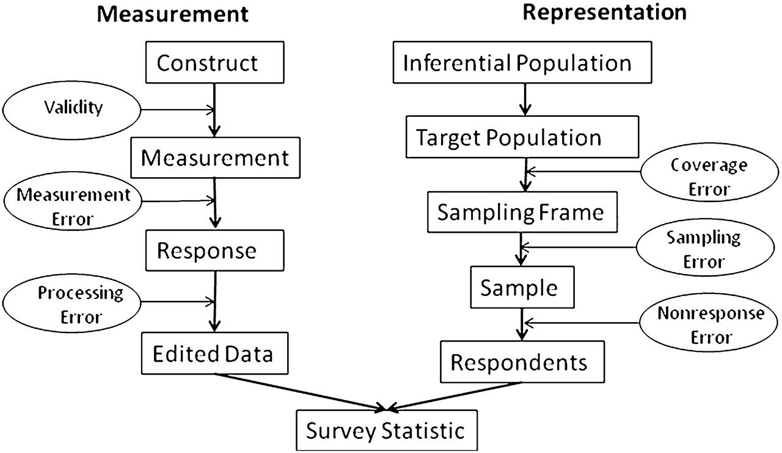
The Total Survey Error (TSE) model

Slide 73
Where does sampling fit in?
During conceptualization, a researcher considers the RELEVANT POPULATION for evaluating the theory/hypothesis
In designing the data collection, the researcher has two concerns in mind:
External validity
Cost/benefit calculations for the overall cost of the study

Slide 74
A sample involves a selection of a representative subset of a population in order to draw inferences to the population
Collecting data from a sample of a large population is FAR LESS costly and FAR LESS time consuming

Slide 75
Because of the cost savings, sampling allows a researcher to devote more resources to the collection of more data (variables), the reduction of error in measurement (reliability and validity), and better coverage of the units of analysis

Slide 76
Important sampling concepts
POPULATION: The set of all relevant units of analysis defined by the researcher on a theoretical or conceptual basis (equivalent to the relevant population)
ELEMENT: The technical term for one unit from the population

Slide 77
Important sampling concepts
SAMPLE (SAMPLING) FRAME: A list of all of the elements in the population from which a sample might be drawn
SAMPLE: The set of elements drawn from a sample frame to represent the population

Slide 78
Important sampling principles
The goal is to select a representative set of units for cost-effective data collection in order to draw inferences about the population they come from
To draw inferences about a population parameter, a probability method must be used (average age, accident rate)
A sample can be evaluated on the basis of its design as well as its implementation
We use statistics to estimate parameters

Slide 79
A sample design should:
1. Involve a probability method
  Every element has known, non-zero probability of selection
2. Be implemented in a way that produces high coverage - the response rate should be maximized

Slide 80
How bad samples are produced
Poor design
  Probabilities of selection are unknown
Inadequate frame
  Does not contain the entire population
  Omission and can lead to bias
Poor Execution
  Response rates are low and can result in bias

Slide 81
Properties of a good sample frame
Complete Coverage
  A list of all elements in the population
Relevant Coverage
  Does not contain extraneous elements
Non-duplicative coverage
  Contains each element only once

Slide 82
Types of sample designs
PROBABILITY DESIGNS
Every element in the population has a known, non-zero probability of selection (but not necessarily equal)

Slide 83
Types of sample designs
PROBABILITY DESIGNS
SIMPLE RANDOM SAMPLES: EPSEM (Equal Probability of Selection Method)
  Probabilities are exactly equal

Slide 84
Types of sample designs
PROBABILITY DESIGNS
STRATIFIED SAMPLES: Unequal selection probabilities in order to facilitate comparisons between theoretically relevant subgroups in a population

Slide 85
Stratified samples
Elements in the population have different (unequal) probabilities of selection
This is like drawing two separate samples, each of which is a probability design, and analyzing the data separately
But the data have to be weighted if they are combined to produce a population estimate in order to account for the unequal probabilities

Slide 86
This was the basis for a recently reported error about teenage drinking:
“Teenagers consume almost 25%of all alcohol”
Survey of 25,500 Americans with an oversample of 10,000 12 to 20 year olds (about 40% of the sample although about 20% of the population)
So their 22% of consumption (unweighted) turned out to be 11% when weighted – about their proportion of the population

Slide 87
Types of sample designs
PROBABILITY DESIGNS
CLUSTER SAMPLES: Selecting units by proximity to reduce the costs of contact, especially travel

Slide 88
Types of sample designs
PROBABILITY DESIGNS
SYSTEMATIC SAMPLES: Selection of units at intervals based upon a random start

Slide 89
In systematic samples, a researcher has:
1. A SAMPLING RATE (depends on desired sample size)
2. An INTERVAL (the division of the frame into equal parts)
3. A STARTING POINT (selected at random within the interval)

Slide 90
Types of sample designs
NON-PROBABILITY DESIGNS
These generally violate the principle of every element in the population having a known, non-zero probability of selection
The probabilities of selection are unknown or some elements have no chance of selection (P = 0)

Slide 91
Types of sample designs
NON-PROBABILITY DESIGNS
AVAILABILITY or CONVENIENCE SAMPLES:
Involve taking whomever is available. There are no known probabilities of selection (Going to the street corner)
Readily available samples are often used in exploratory work

Slide 92
Types of sample designs
NON-PROBABILITY DESIGNS
VOLUNTEER SAMPLES:
There are no known probabilities and self-selection can introduce bias. (Inserting a questionnaire in a magazine, a newspaper, or a web site)

Slide 93
Types of sample designs
NON-PROBABILITY DESIGNS
PURPOSIVE SAMPLES: Subjects selected on the basis of an attribute that gives those without it a selection probability of zero
Not generally representative
(Using only AWD or 4WD cars to study their drivers)

Slide 94
Types of sample designs
NON-PROBABILITY DESIGNS
QUOTA SAMPLES: A haphazard method where selection is often left up to the interviewer. This discretionary element introduces bias.
Find me 10 women drivers, 5 young drivers, 10 male drivers, 5 older drivers

Slide 95
Important issues in asking questions
1. Kinds of questions (behaviors, knowledge, attitudes).
2. Question wording problems.
3. Response alternatives
4. Interviewer effects
5. Question order effects

Slide 96
Important issues in question asking
1. Kinds of Questions: Behaviors, Knowledge, Attitudes
A. Behavioral Reports
  Focus on the current, specific, and real
  Short reference periods
  Use highly salient events to key memory

Slide 97
How often do you drive your car?
How many miles did you drive last week?
How many miles did you drive last year (2015)?

Slide 98
Important issues in question asking
B. Knowledge Questions
  Need to be careful about giving cues (question order and wording)
  What is “relevant knowledge?” (validity)
  Recall versus recognition

Slide 99
Important issues in question asking
C. Attitudes (and non-attitudes)
Much research shows that behavior is often unconstrained by attitudes. Why?
Is a survey the best way to measure attitudes?
Some issues are complicated
Sometimes people haven’t thought much about them (Offer an explicit “Don’t know”?)

Slide 100
Question Wording: Explicit DK
In general, do you think public opinion polls are a good thing for the country or a bad thing? (GALLUP)
Good thing 87%
Bad thing 8
Not sure, don’t know 5
(volunteered)

Slide 101
In general, do you think public opinion polls are a good thing for the country or a bad thing – or don’t they make any difference one way or another? (UM)
Good thing 39%
Bad thing 10
Don’t make any difference 46
Not sure, don’t know 5
(volunteered)

Slide 102
Question Wording: Complexity
Questions must be written so that everyone can understand them
Avoid complex vocabulary, uncommon words, phrases, events, or policies

Slide 103
Do you think that the VITRONIC system has been very effective in reducing traffic speeds on Doha roads?
Do you favor or oppose the use of Thimerosal in flu vaccines?

Slide 104
Question Wording: Double negatives
It is difficult to answer in the affirmative to questions with two negative statements:
“Do you never avoid driving above the speed limit?” (Yes / No)

Slide 105
Question Wording: Leading phrases
The invocation of authority can bias the response
Do you agree with Ministry of Transportation’s decision to replace roundabouts with traffic lights? (Agree/Disagree)
Do you think Qatar should further increase enforcement of traffic laws? (Yes, should / No, shouldn’t)

Slide 106
Scientific credibility: MADD survey
Q2. Today, most states define intoxicated driving at .10 percent blood alcohol content, yet scientific studies show that virtually all safe driving skills are impaired at .08. Would you be in favor of lowering the legal blood alcohol limit for drivers to .08?
Yes or No

Slide 107
Question wording: “Double-barreled” questions
Multiple response alternatives are offered in the question “stem” so agreement can have multiple meanings.
Would you consider buying a car or a refrigerator now? (Yes or No)

Slide 108

Question wording: “Double-barreled” questions
Multiple response alternatives are offered in the question “stem” so agreement can have multiple meanings.
Would you consider buying a car or a refrigerator now? (Yes or No)
Yes Yes
No No

Slide 109
Question wording: Unbalanced questions
Unbalanced Question Wording
Should we raise taxes in order to pay for things like education, health care, and defense spending?
The question is unbalanced, because it implies a single tax dollar can go a long way
Better wording: Should we raise taxes in order to pay for social programs?
I am going to read you list of social programs, and I would like you to tell me which ones should receive more tax money, which ones should receive less, and which ones should stay the same.

Slide 110
Unbalanced response options
How do you feel about a new law to increase fines for drivers who speed … would you favor it strongly, favor it somewhat, or oppose it?

Slide 111
Question wording: Threatening questions on sensitive topics
People are reluctant to reveal intimate personal information or the degree to which they violate social norms
Could lead to underestimates of risky behaviors

Slide 112
How many times in the last month have you driven a car more than 10 kilometers an hour over the speed limit?
How often do you use your seat belt?

Slide 113
Question wording: Social Desirability
Asking a question in which one answer is more socially appropriate, or polite.
Not about intimate behaviors, but still there is pressure to give the “right” answer.
Did you vote in the last election?
Do you intend to vote in the November election?

Slide 114
Have you ever driven when you were too tired?
Is it all right to hit your children if they misbehave?
Should women with young children work outside the home?

Slide 116
SESRI
Policy & Program Evaluation Workshop
Doha, Qatar
May 29-June 1, 2016

Slide 117
Outline: Session 4
SESRI 2014 Omnibus Survey
  Codebook and metadata
  Study design
  Sampling
  Variables
  Weights
Activity 2: Managing Survey Data

Slide 118
Codebooks and Metadata
Most researchers today are performing secondary analysis based on data collected by others (or at least they were not involved in the design and collection of the data)
What are the advantages and disadvantages of that?
  Usually means better data than otherwise possible
  Likely to get to analysis faster than if you had to design and collect your own data
  Measurement often involves compromises

Slide 119
Codebooks and Metadata
Documentation becomes critical for secondary analysis – whether you are preparing data for others or using others’ data
The basic element of documentation is a codebook, which is more than variable descriptions

Slide 120
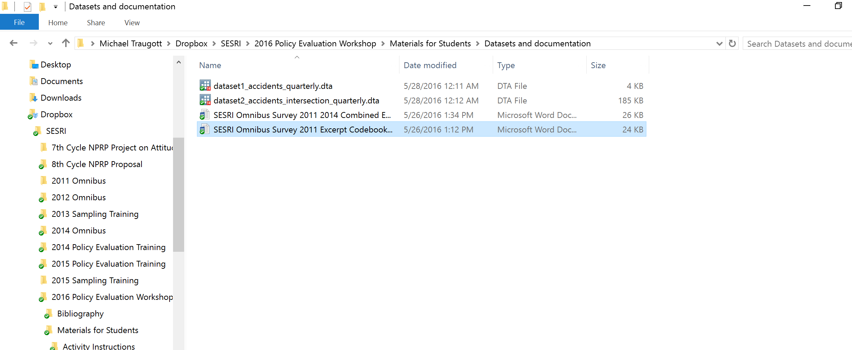
Downlaoad the codebook for the 2011 SESRI Omnibus dataset

Slide 121

Download the codebook for the 2011 SESRI Omnibus dataset

Slide 122

Download the codebook for the 2011 SESRI Omnibus dataset

Slide 123
Variables
Descriptive elements of a variable
Short name in the dataset
Source of the variable
Expected valid values
Missing data values
Frequencies of each value
Any additional properties (conditional or skip patterns)

Slide 124
Activity #2
Prepare a survey dataset for analysis
  Coding/recoding
  Creating new variables
  Labels
  Merging datasets

Slide 125
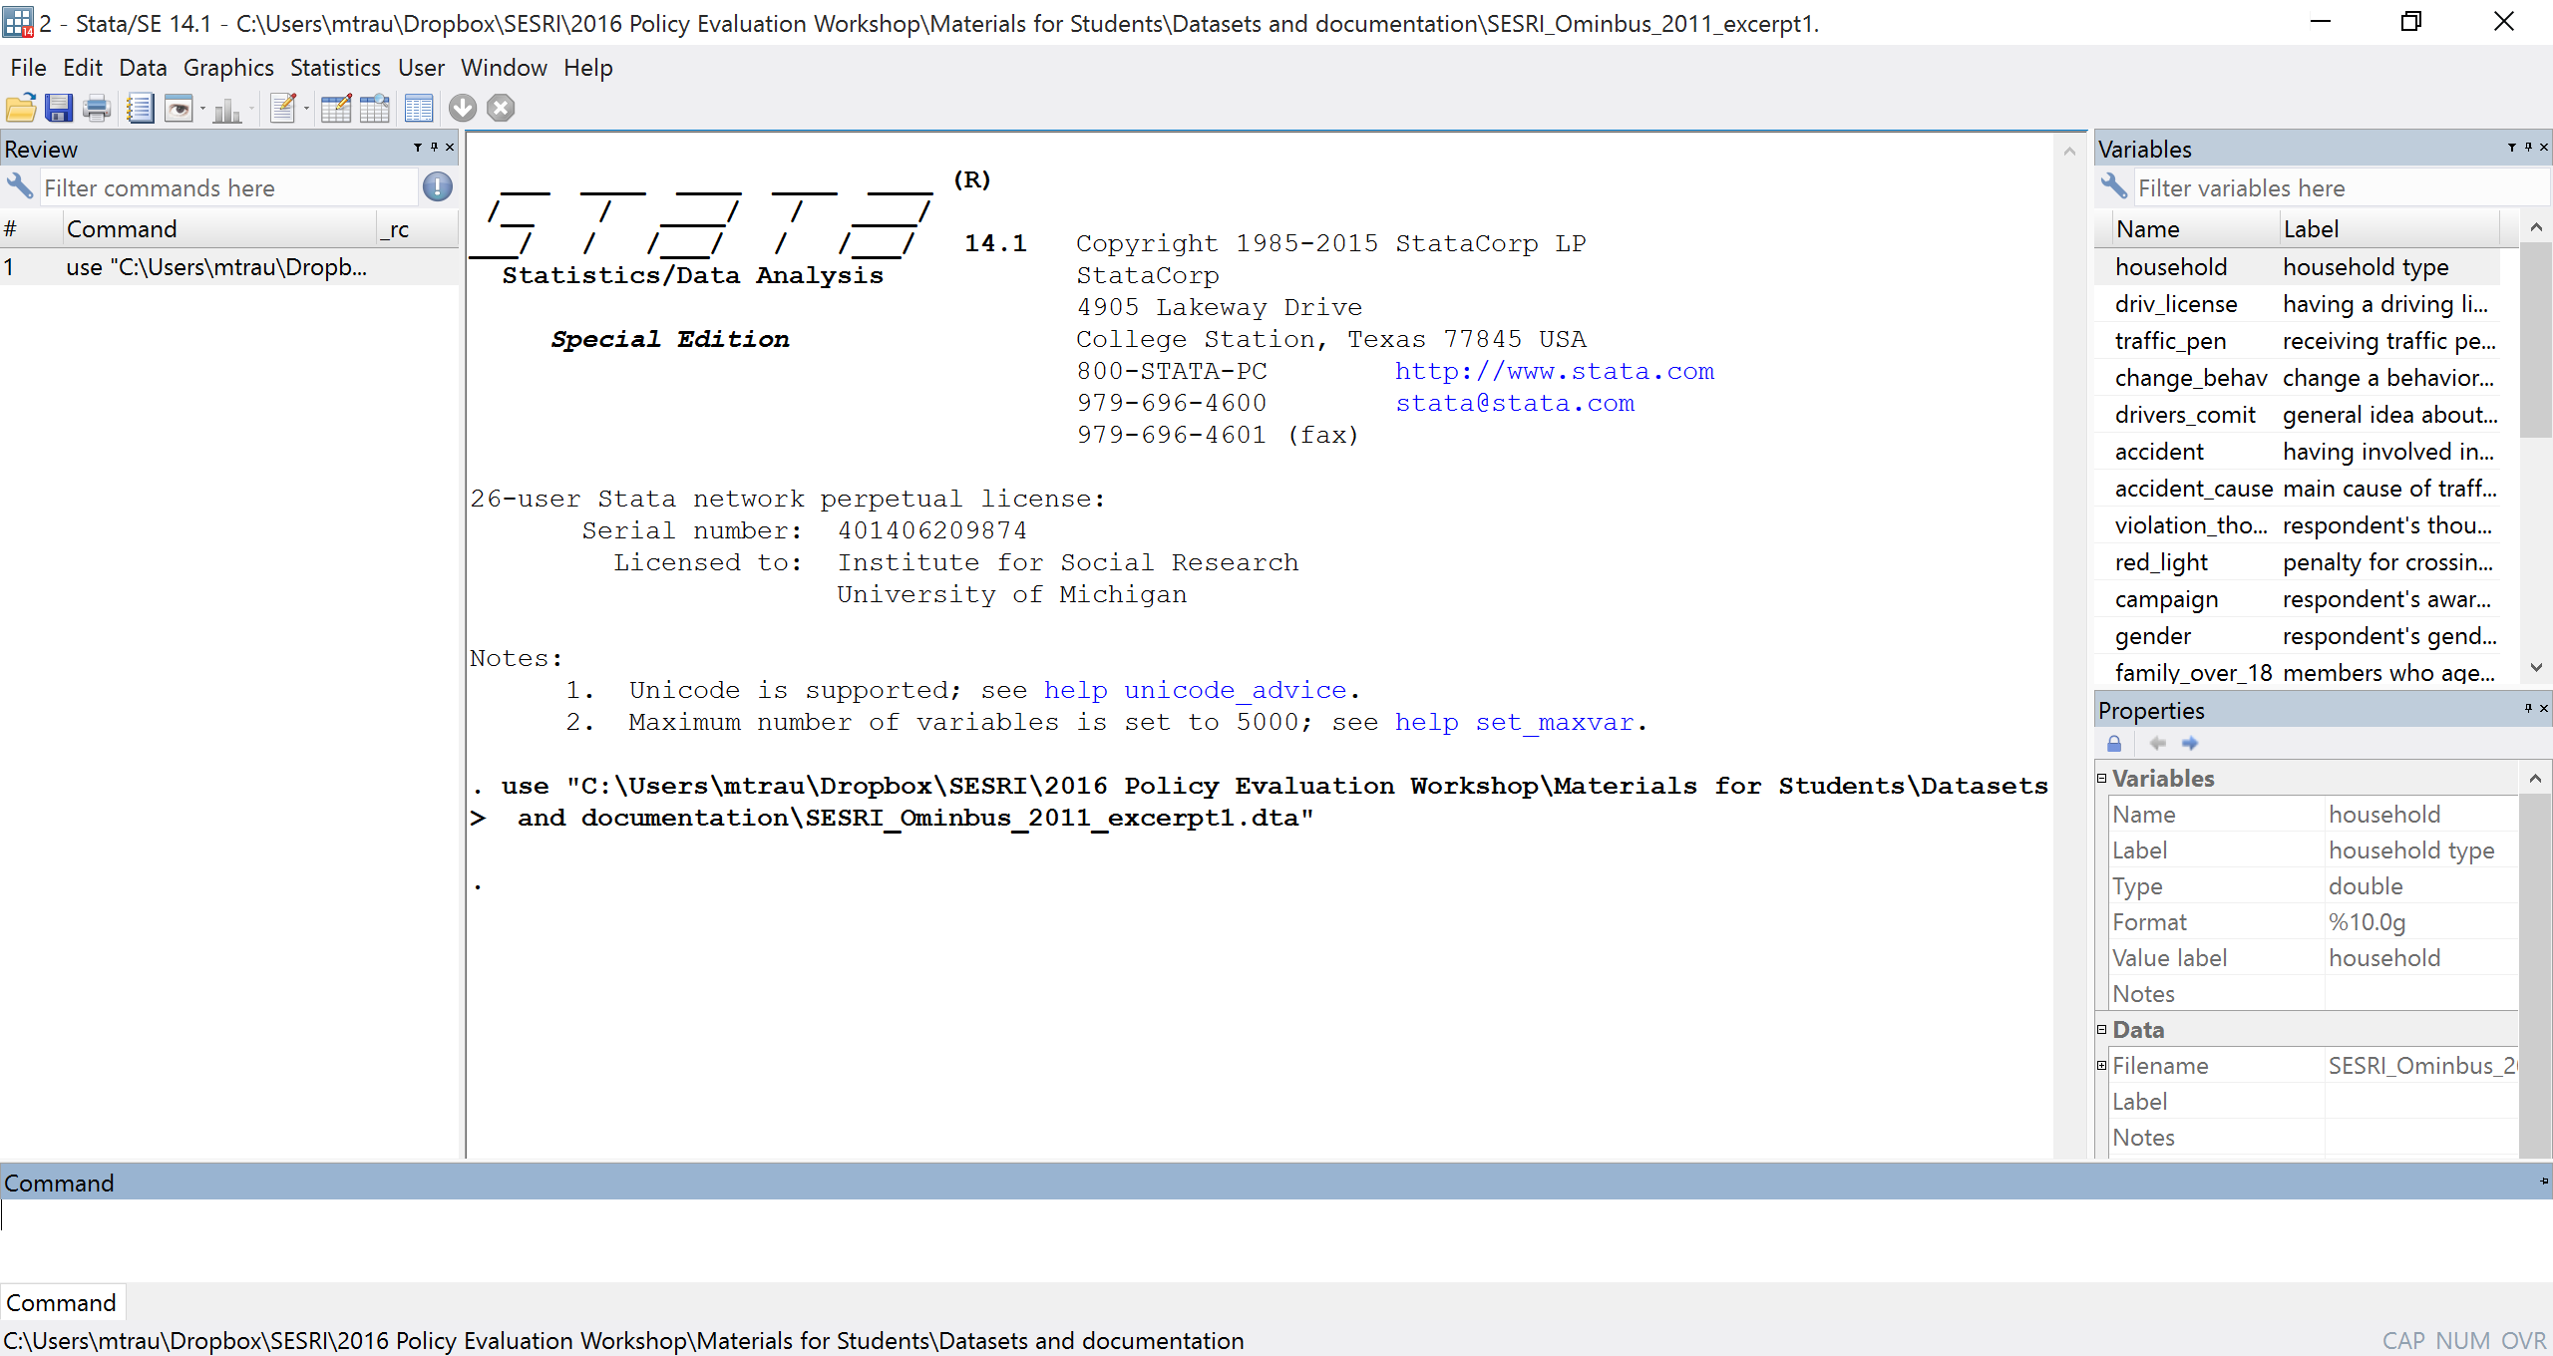
Checking the dataset properties in Stata
Notes:
This slide shows a highlighting of the variable list

Slide 126
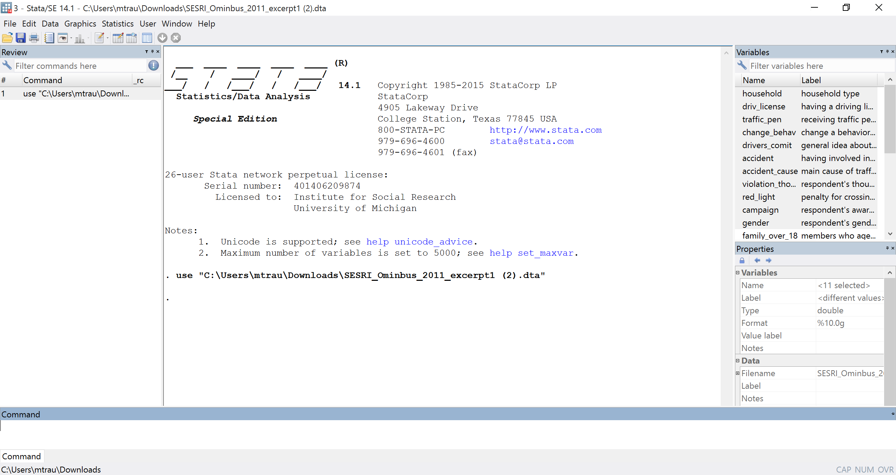
Checking the dataset properties in Stata

Slide 127
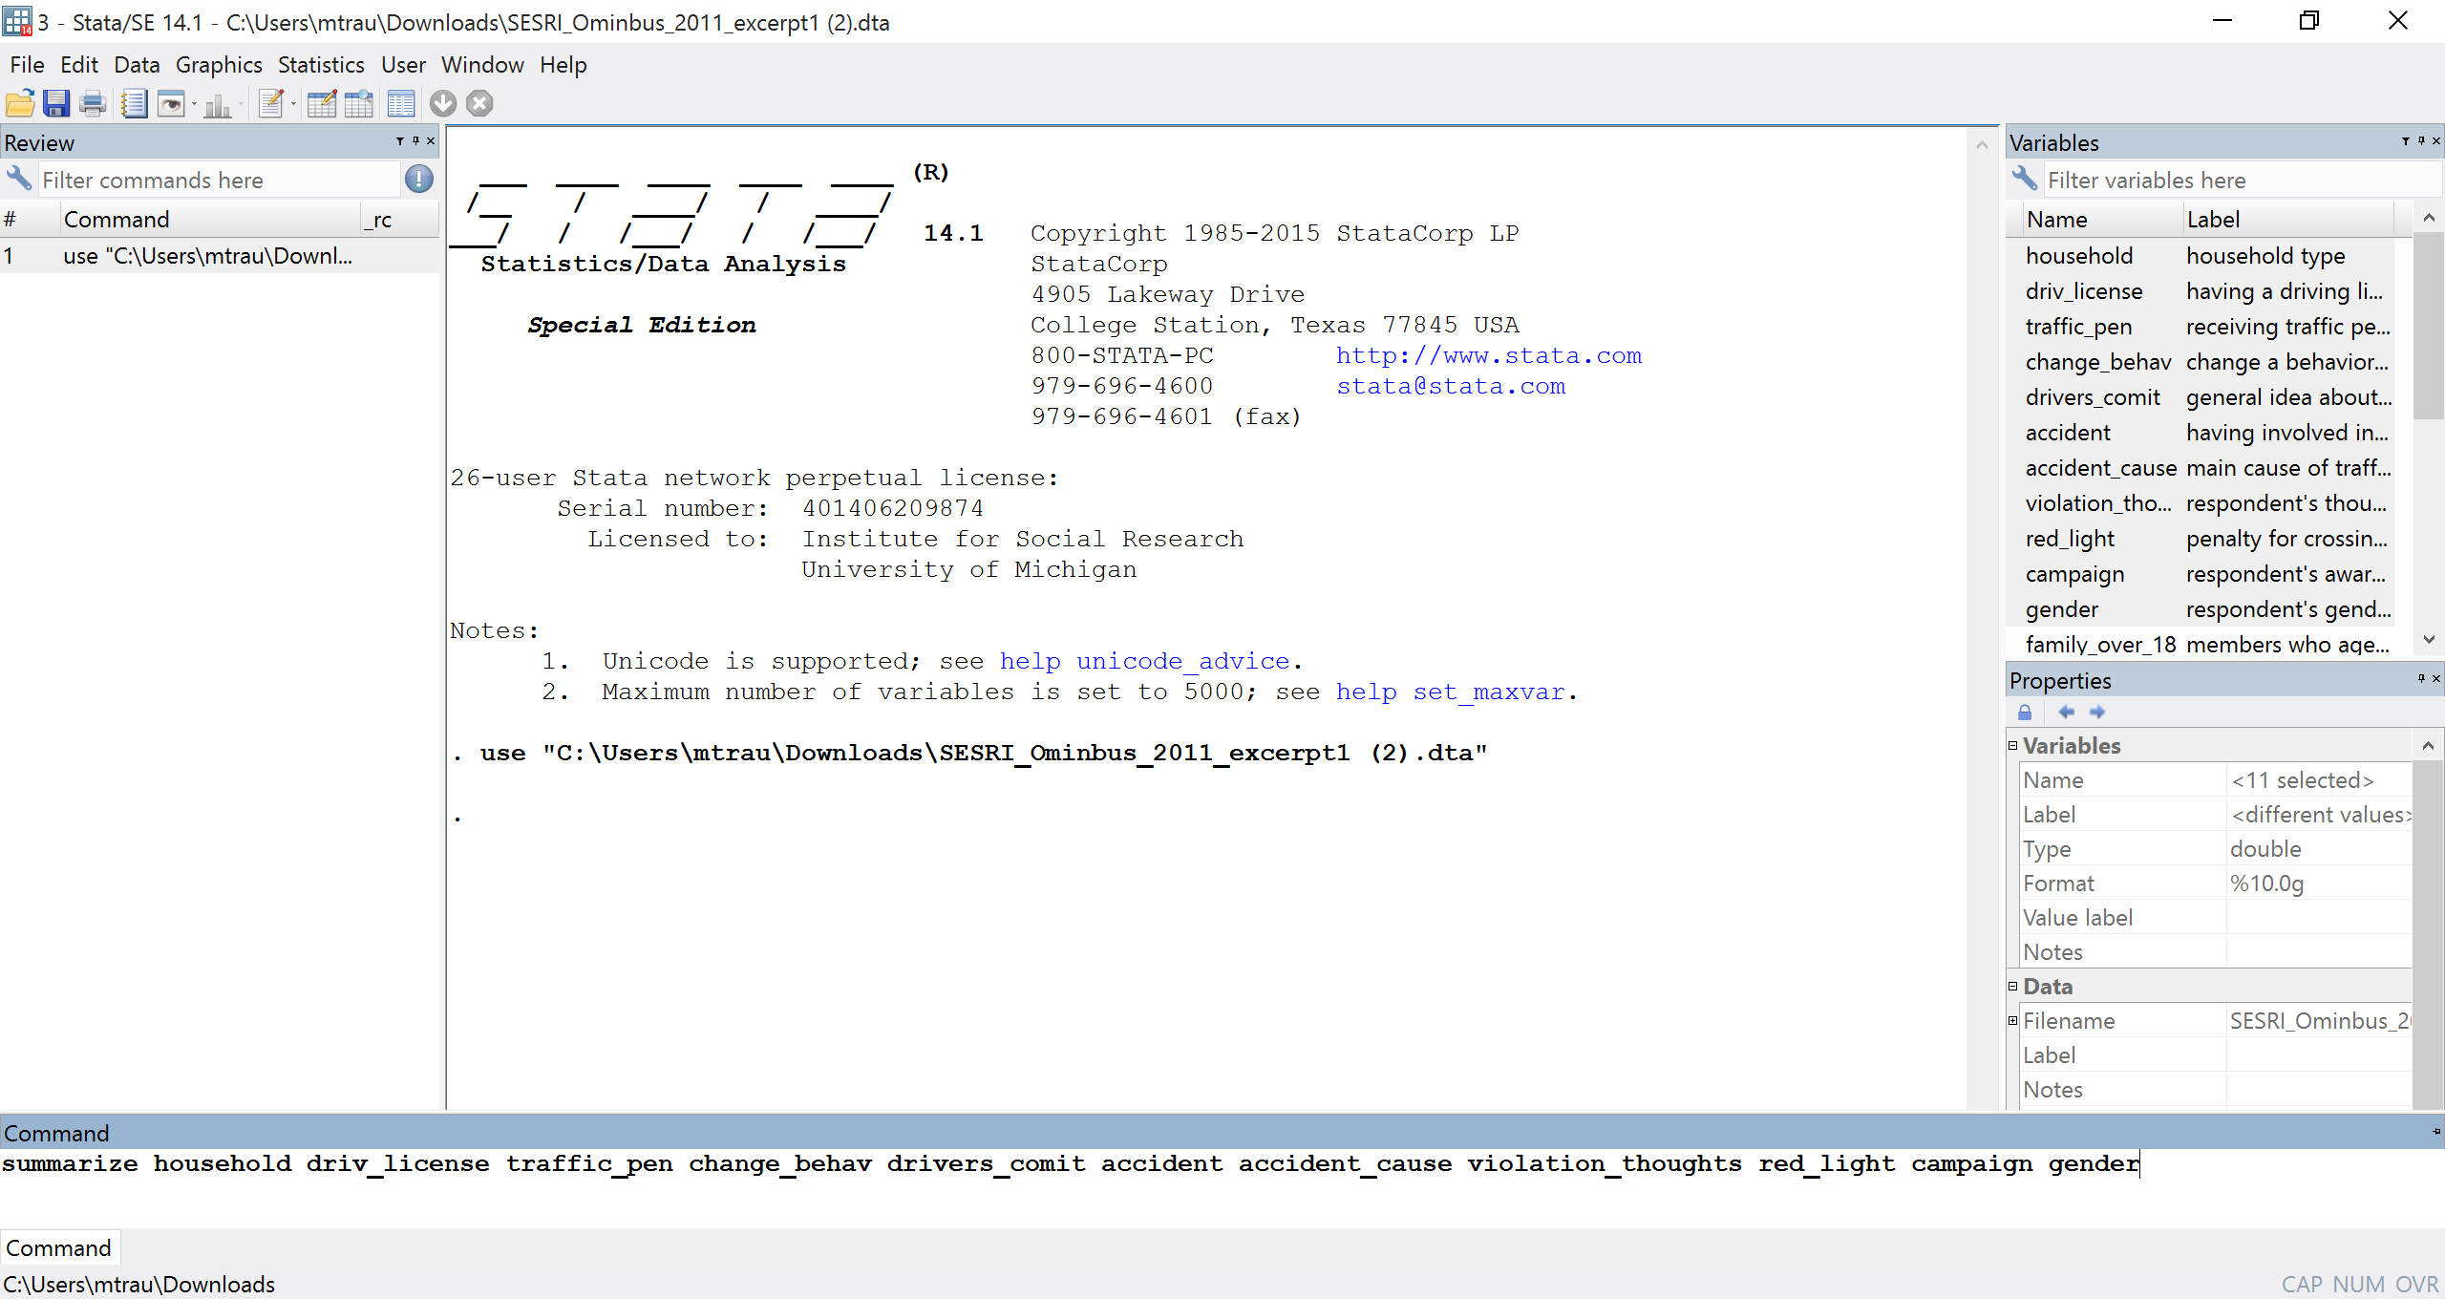
Checking the dataset properties in Stata

Slide 128
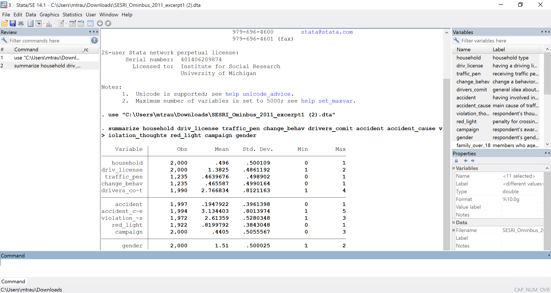
Checking the dataset properties in Stata
Notes:
Unweighted descriptives

Slide 129
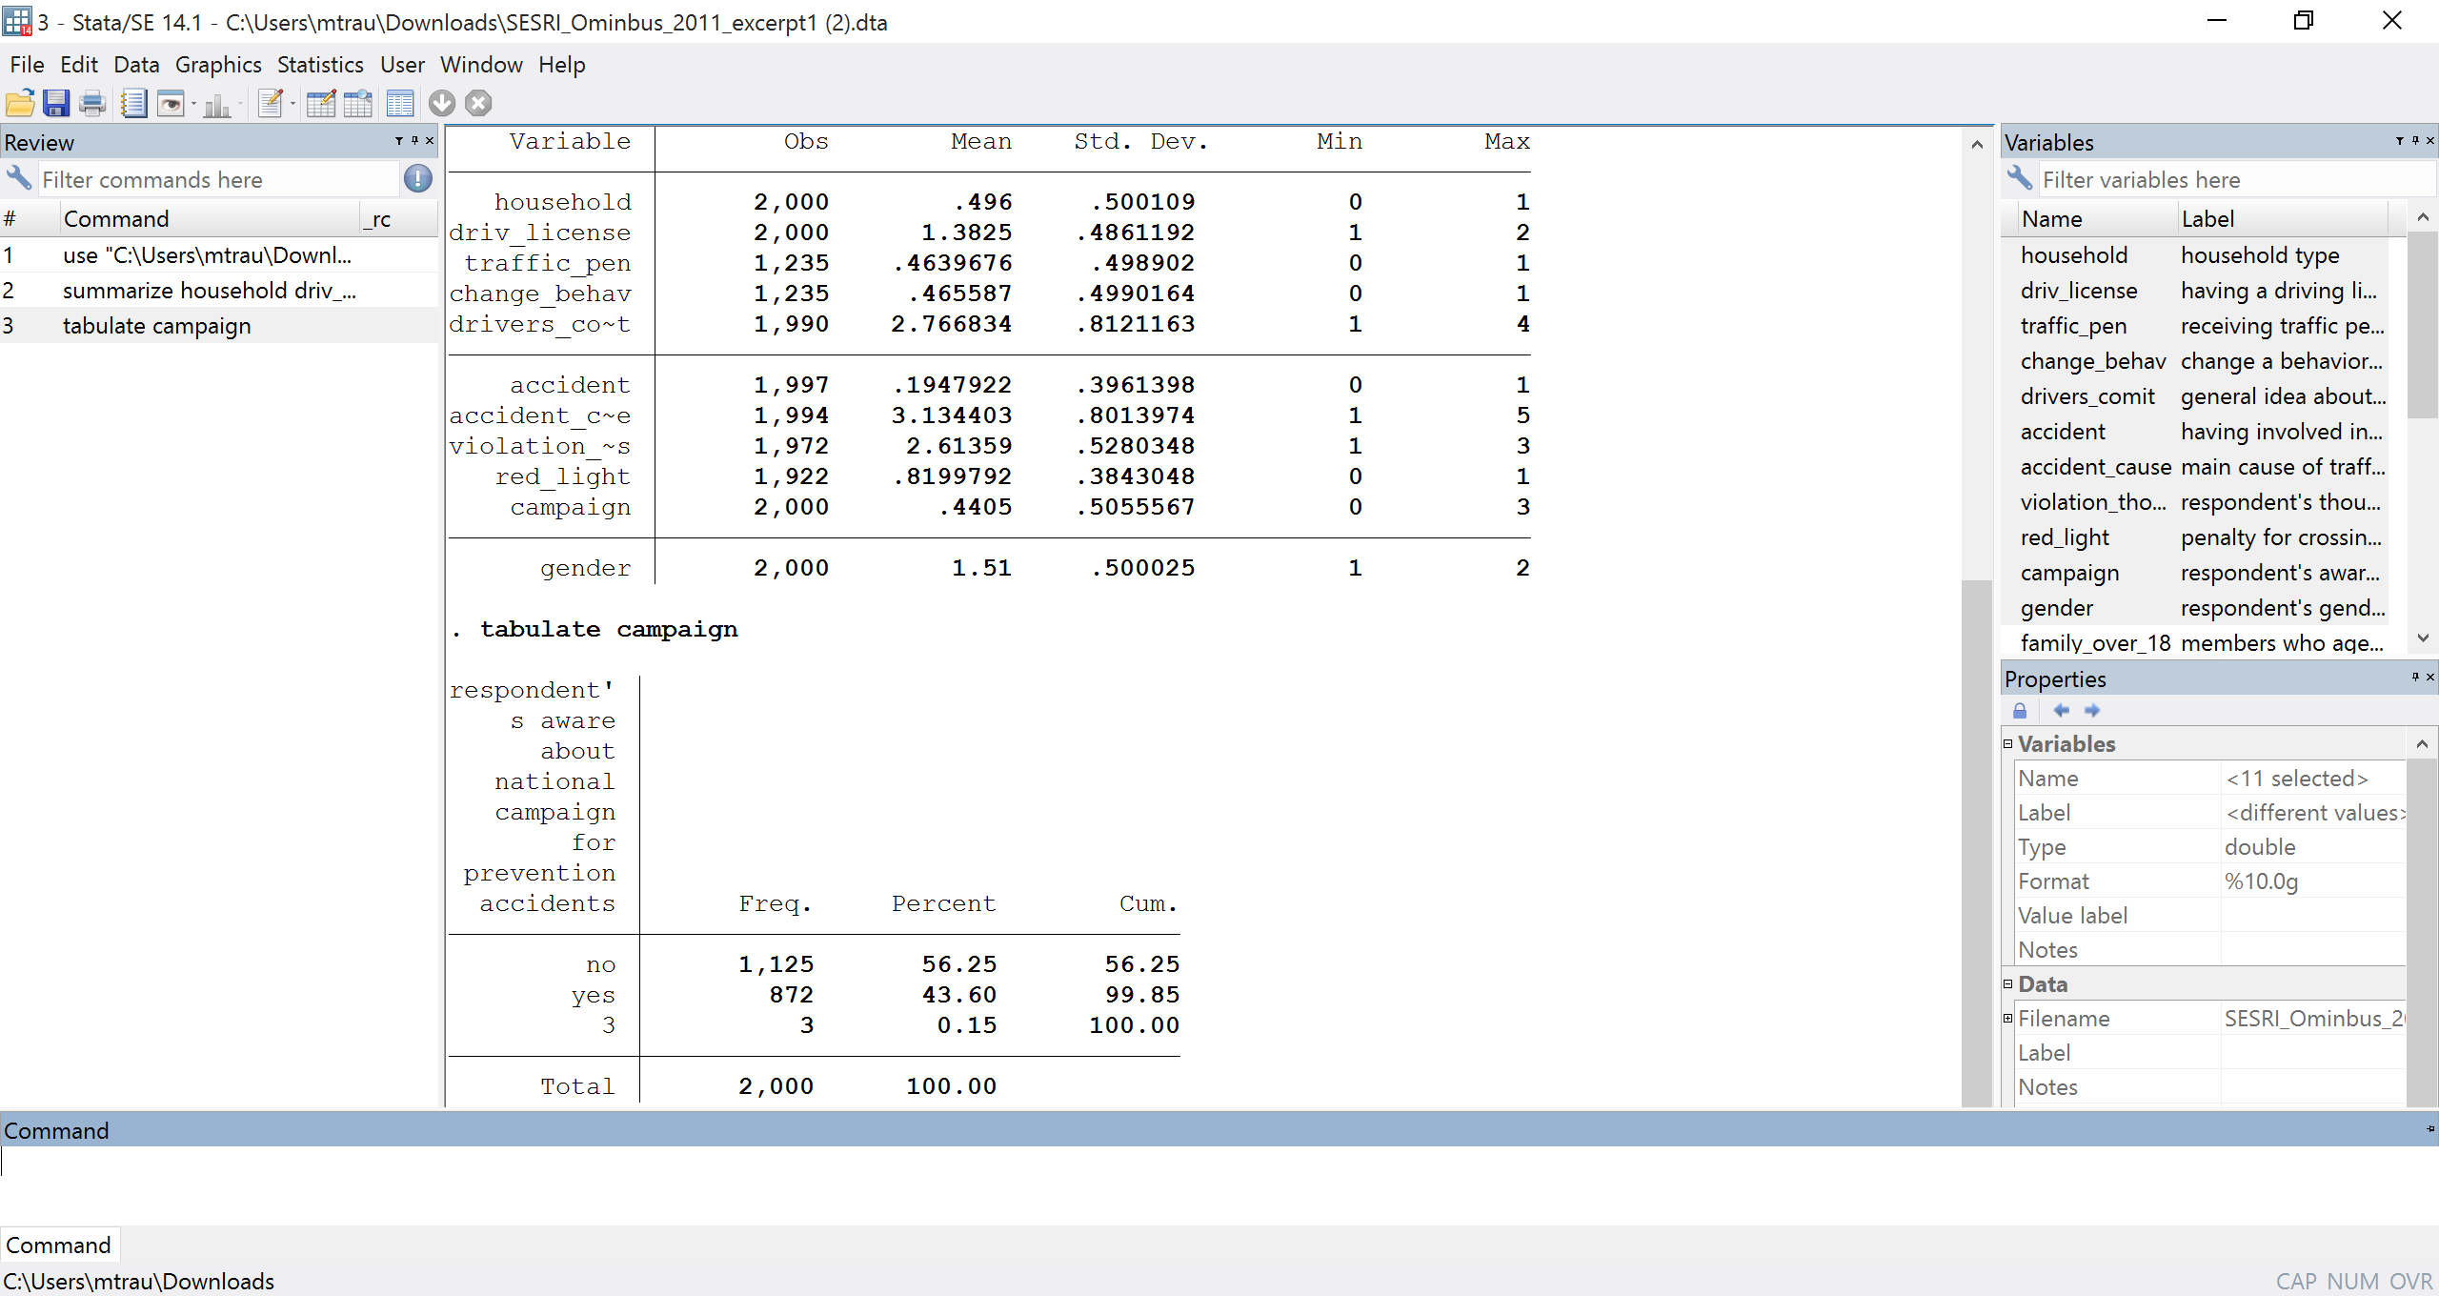
Checking the dataset properties in Stata
Notes:
Unweighted frequencies for a variable that doesn’t correspond to the codebook

Slide 130
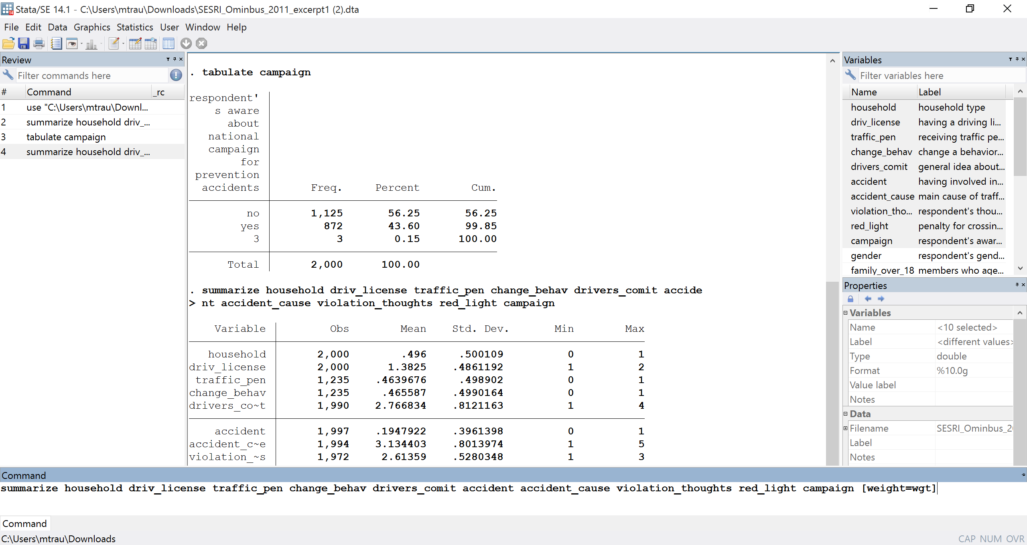
Weights
Notes:
Weighted descriptives

Slide 131
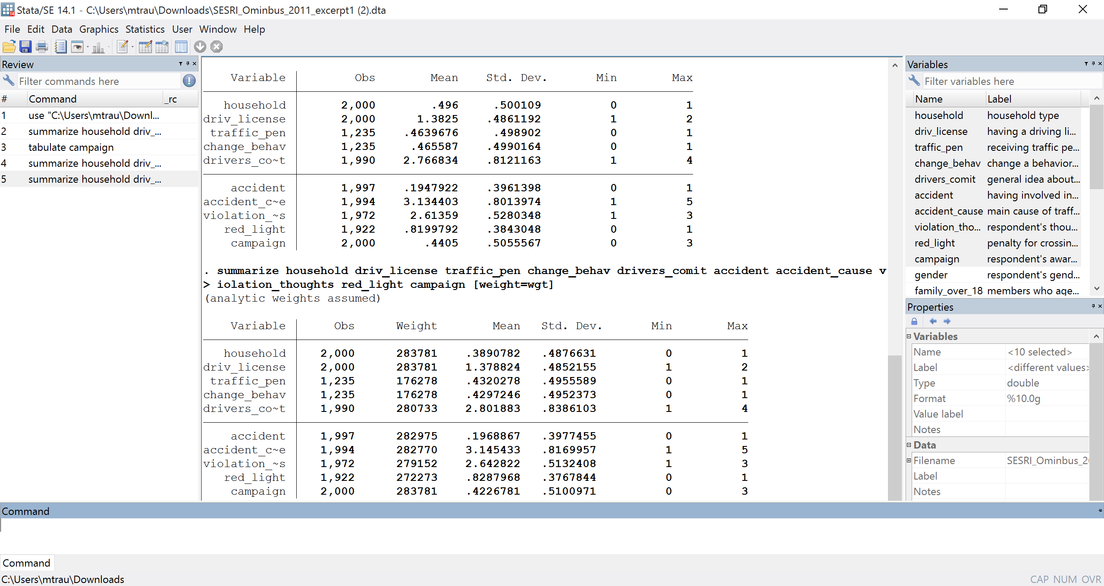
Weights

Slide 132
Data Management

Slide 134
SESRI
Policy & Program Evaluation Workshop
Doha, Qatar
May 29-June 1, 2016

Slide 135
Outline: Session 5
Operationalization
Measurement
Reliability and Validity
Measurement Theory
  Random error
  Bias

Slide 136
Operationalization
Deciding on the units of measurement and units of analysis, i.e. defining how the variables will be measured, observed, or formed
All the variables must be measured for the same units of analysis, especially when evaluating a hypothesis
Deciding on which research design will be used to collect the data

Slide 137
Operationalization and Basic
Design Considerations
Can we develop baseline measures on traffic accidents before the road realignment program starts?
Can we create a panel study/longitudinal data file with repeated measures over time?
Can we develop an appropriate control group(s)?
How many different units of analysis can we use?
Notes:
Ask students:
Why would you use receipts vs. self-reports? Why would you use longitudinal vs. cross-sectional?

Slide 138
Measurement
H: Changing road configuration will reduce traffic accidents.
How would we measure X (road configuration) and Y (traffic accidents)?
You must agree on the units. What is a common “unit of analysis” for road configuration and of traffic accidents?
Notes:
Amount an individual receives? Amount a project receives?
Amount an individual contributes? What share an individual contributes?

Slide 139
Measurement
For any measure, we can think about the observation consisting of a true score, plus some error.
Observed Value = True Value + Error

Slide 140
Measurement Error
For any measure, we can think about the observation consisting of a true score, plus some error.
Random errors are due to chance fluctuations, and they average to zero. In general, they contribute to imprecision.
Systematic errors are not due to chance and they have a direction or "bias.” They can raise concerns about either reliability or validity .

Slide 141
Measurement Error
Since the error can be either random or systematic or both:
Observed
Value
True
Value
Random
Error
Systematic
Error
=
+
+

Slide 142
Reliability and Validity
Reliability and validity refer to possible measurement errors
  Reliability refers to how consistent or precise the measurement is
  Validity refers to whether we are measuring what we think we are (the concept)

Slide 143
Reliable, Not Valid

Slide 144
Valid, Not Reliable

Slide 145
Not Valid, Not Reliable

Slide 146
Valid and Reliable

Slide 147
Expected Observations with Repeated Measurement
High
Second measurement
Low
High
First measurement

Slide 148
Repeated Measurement with Random Error
200 QR
Individual report
of saving
0 QR
Bank account transfers
200 QR
What is the correlation summarizing this relationship likely to be?

Slide 149
Repeated Measurement with Systematic Error (Bias)
200 QR
Individual report
of saving
0 QR
Budget balance
200 QR
What are possible explanations for this observation?
Notes:
What could explain this systematics error? Not all of the money is being sent home through bank transfers
What is the correlation summarizing this relation likely to be?
Could also make an estimate of per work remittances (average) and multiply by the estimated number of workers in Qatar by nationality, producing a net outflow estimate. This could be checked against the World bank data base.
How does it compare to the hypothetical relationship that came before?

Slide 150
Measurement Strategy
Class Discussion
How can we measure accidents and whether they change over time in relation to a policy initiative?

Slide 151
Created Two Contrived Datasets
Accidents per quarter over time
Accidents per intersection over time

Slide 152
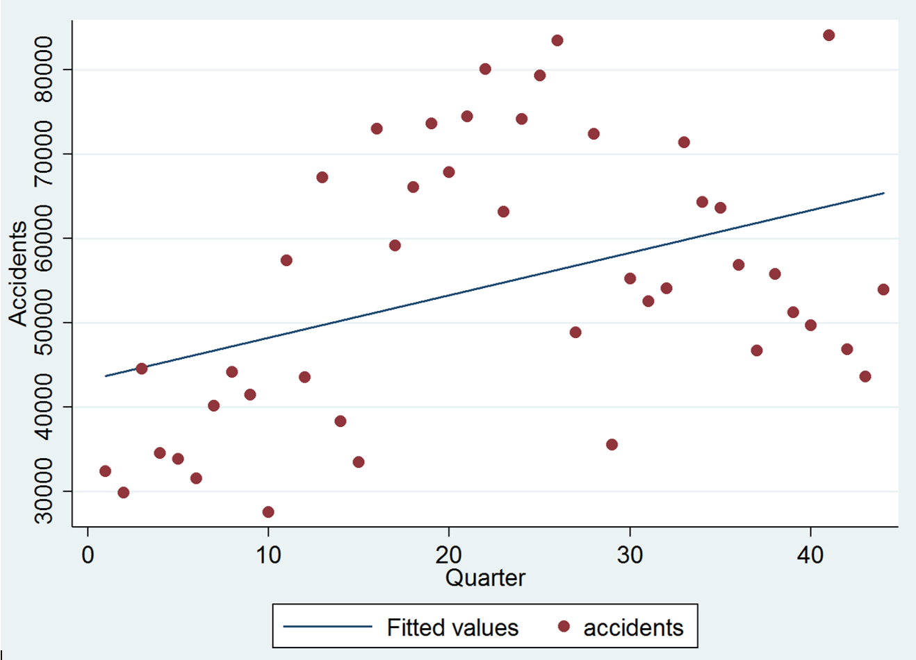
Measurement Strategy
Class Discussion
Notes:
Could also make an estimate of per work remittances (average) and multiply by the estimated number of workers in Qatar by nationality, producing a net outflow estimate. This could be checked against the World bank data base.

Slide 153
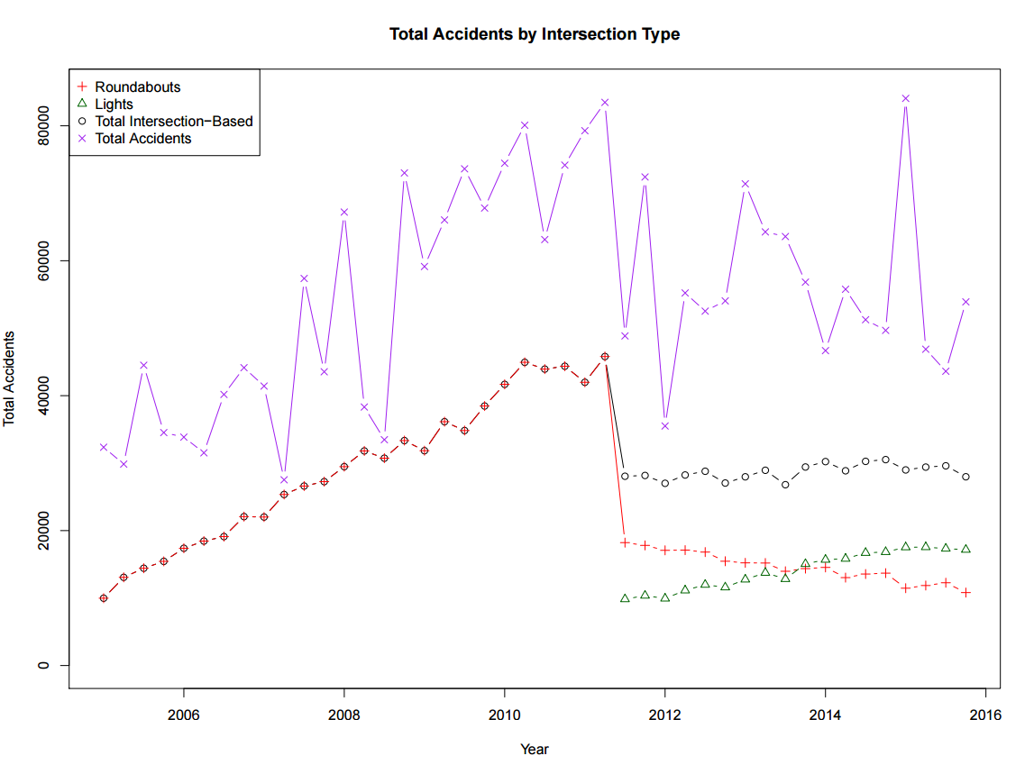
Measurement Strategy
Class Discussion
Notes:
This is how the simulated data in the aggregate look compared to the original time series we made up. Why is that?
Because of the assumptions used in the creation of the data:
- Each intersection has some amount of traffic, that increases linearly over time.
- Lights are introduced as an option in the third quarter of 2011; about half of intersections are switched over.
- Lights have 1/3 the accidents of roundabouts for the same amount of traffic
- No intersections ever cease to exist
- All new intersections are created as roundabouts, then converted if and when the traffic becomes large enough (and only after 2011Q3)
- Threshold of traffic to create an intersection (roundabout) and to upgrade to a light goes down slightly over time.
- Intersections start out comprising about 40% of traffic accidents, but this proportion increases over time.
- There is a moderate amount of normal error around most of these assumptions.

Slide 154
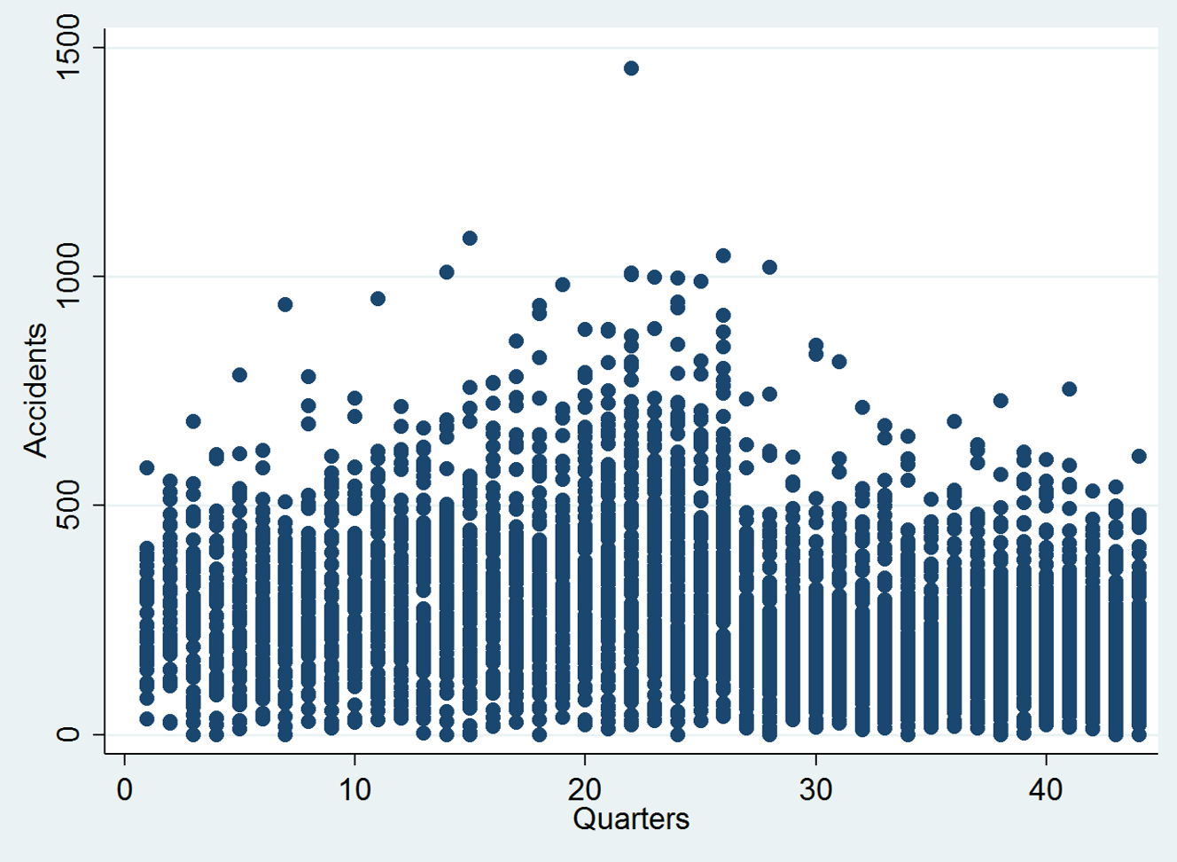
Measurement Strategy
Class Discussion
Notes:
Could also make an estimate of per work remittances (average) and multiply by the estimated number of workers in Qatar by nationality, producing a net outflow estimate. This could be checked against the World bank data base.

Slide 155
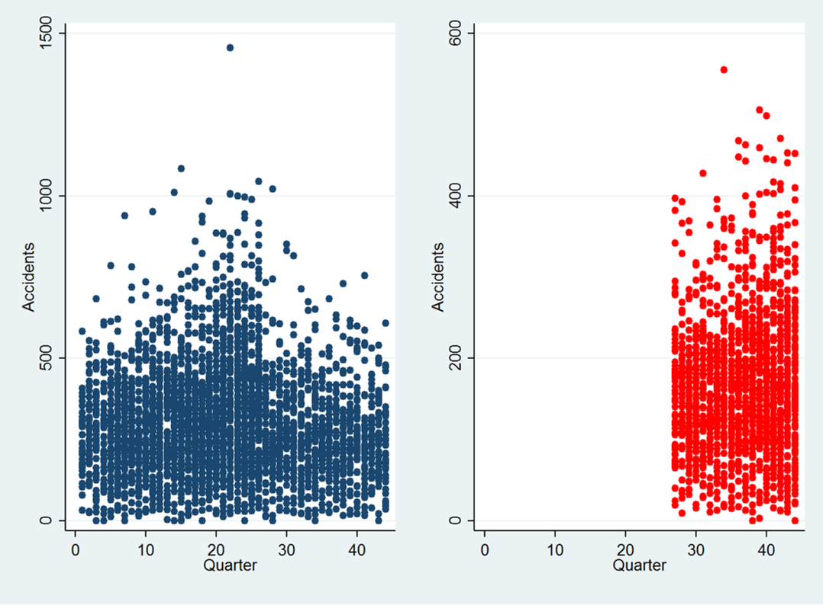
Measurement Strategy
Class Discussion
Notes:
Could also make an estimate of per work remittances (average) and multiply by the estimated number of workers in Qatar by nationality, producing a net outflow estimate. This could be checked against the World bank data base.

Slide 156
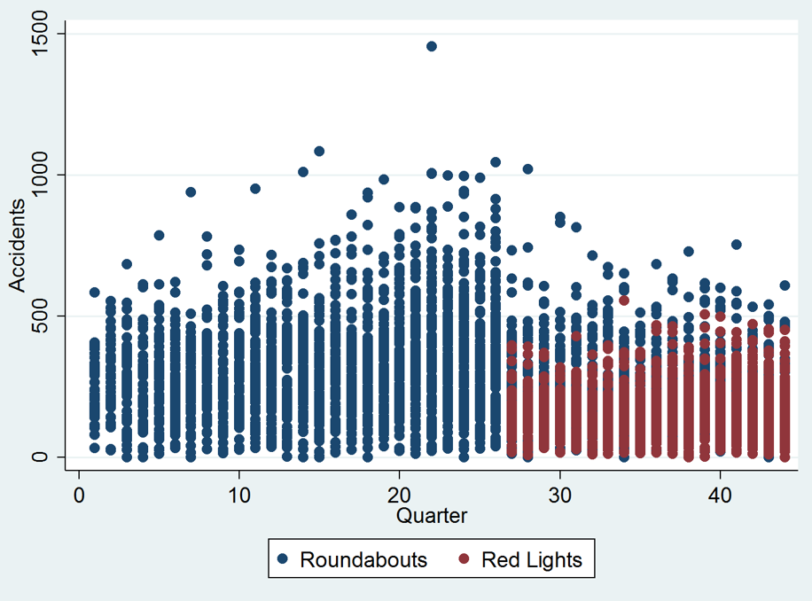
Measurement Strategy
Class Discussion
Notes:
Could also make an estimate of per work remittances (average) and multiply by the estimated number of workers in Qatar by nationality, producing a net outflow estimate. This could be checked against the World bank data base.

Slide 157
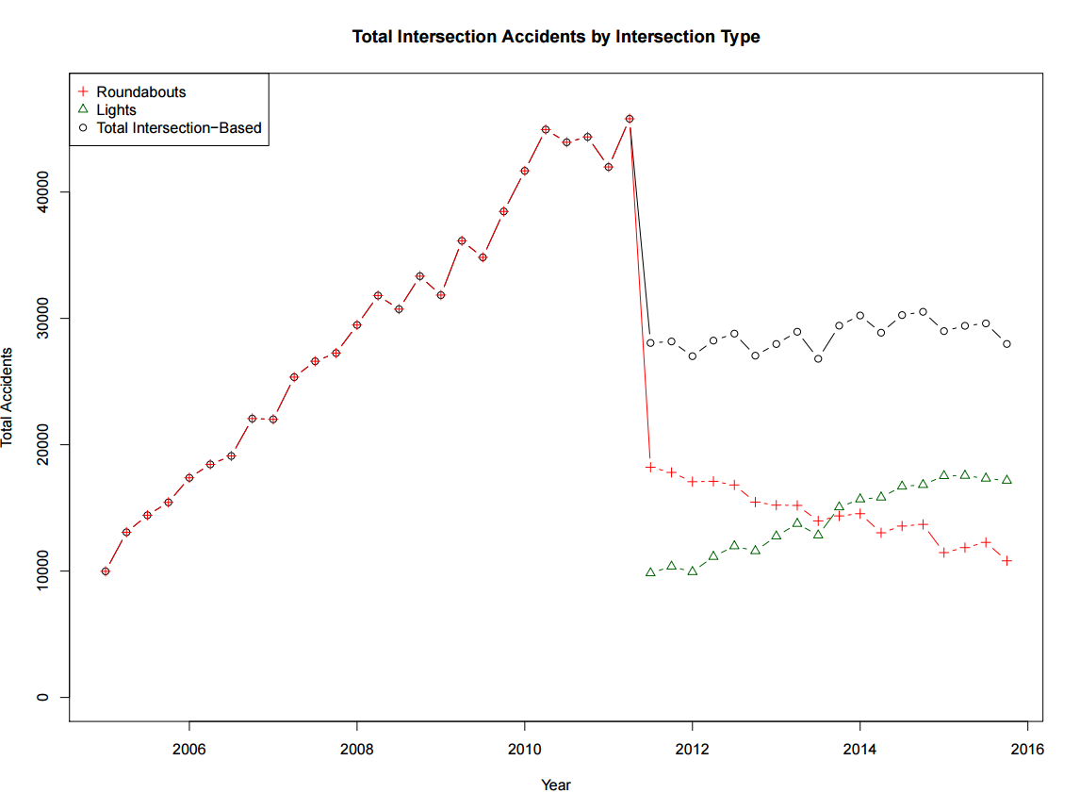
Measurement Strategy
Class Discussion

Slide 158
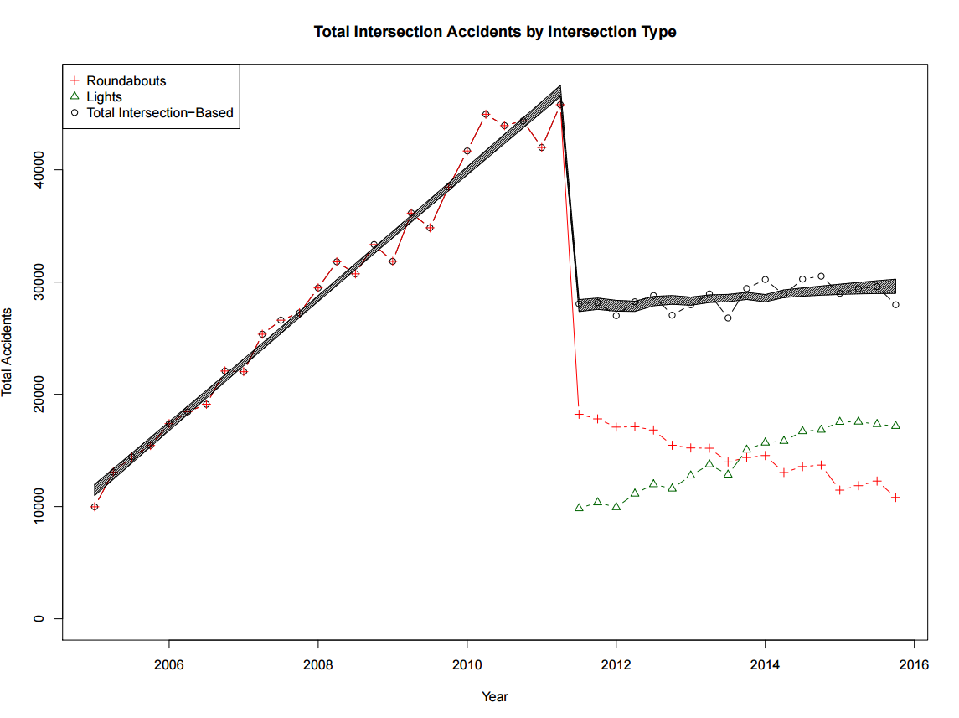
Measurement Strategy
Class Discussion

Slide 159
SESRI
Policy & Program Evaluation Workshop
Doha, Qatar
May 29-June 1, 2016

Slide 160
Outline: Session 6
Descriptive Statistics
  Central tendency
    Mean
    Median
    Mode
  Spread
    Range
    Quartiles
    Variance and standard deviation
Activity #3: Descriptive Statistics

Slide 161
Variables have a number of properties
A variable is different than a constant – it can take on different values
Discrete variables only assume certain values.
Race, sex, type of intersection
Continuous variables can assume any value.
Height, weight, number of accidents

Slide 162
What is univariate analysis?
Describing the properties of a single variable
  Observe the distribution
  A frequency distribution: how frequently does each value occur?

Slide 163
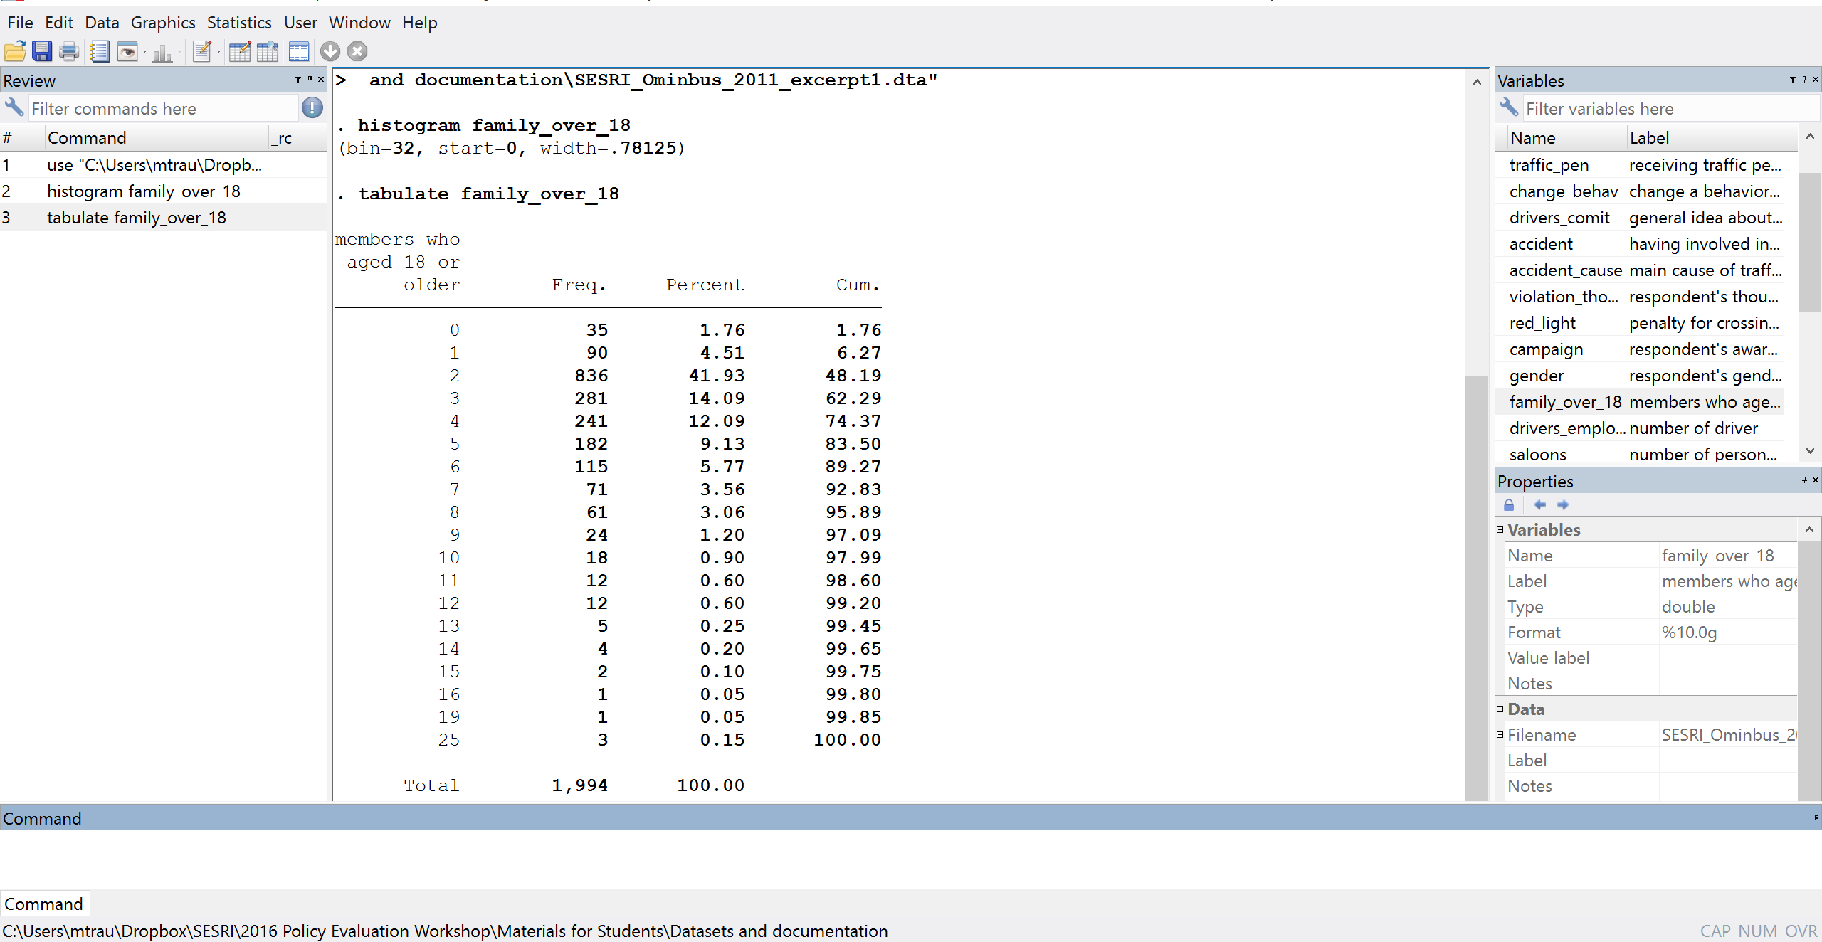
Frequency distribution
The count of the number of times (the frequency) that each value occurs in the sample
This is the tabulate command in Stata

Slide 164
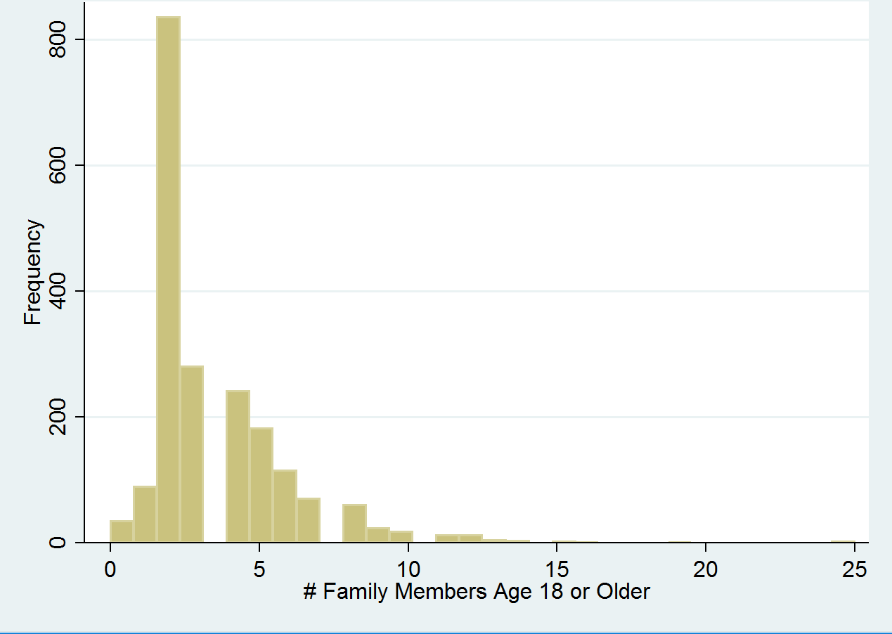
The frequency distribution can be displayed graphically in a histogram

Slide 165
Distributions have important properties
Each of the properties can be characterized by a variety of statistics: Two important ones are:
A measure of central tendency, the “typical” value.
A measure of dispersion, how much do units of analysis vary?
The kinds of statistics used are affected by the level of measurement of the variable

Slide 166
Measures of central tendency
1. The mode: The most frequent value in the distribution What is the mode?

Slide 167
Measures of central tendency
2. The median: The value of the case that splits the distribution into two halves (Also known as the 50th percentile case) What is the median?

Slide 168
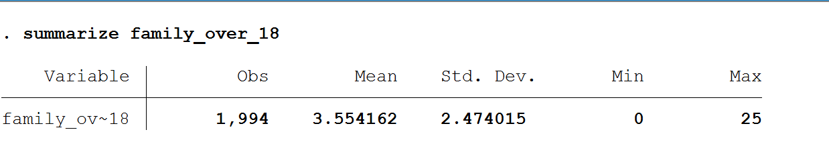
Measures of central tendency
3. The average or arithmetic mean: The sum of all values divided by the number of cases/ sample size
Mean(x)= X_{i}/n

Slide 169
Measures of central tendency
3. The average or arithmetic mean: The sum of all values divided by the number of cases/ sample size
Mean(x)= X_{i}/n
Outliers: individual cases that are highly distinct from the rest of the data
The mean is very sensitive to outliers, while the median and the mode are not.

Slide 170

Mode
Median
Mean
In a distribution with a single peak that is also symmetrical (like the normal distribution) , the mean, median, and mode are very similar.
If there isa normal distribution, the three measures are equal.

Slide 171





What is the relationship between these measures of central tendency?
In a skewed distribution, the median lies out in the tail relative to the mode, and the mean lies even further out.
Distributions of accidents or miles traveled could look like this

Slide 172
When to use what measure of central tendency
Use MODE when data are categorical and mutually exclusive (type of intersection, race of respondent, type of car)
Use MEDIAN when you have extreme scores (respondent income, miles driven last year)
Use MEAN when you have continuous scores, and no outliers (# of days commuting)

Slide 173
Measures of dispersion
How much variation is there in the sample?
1. The RANGE: The difference between the minimum and maximum values.
Range = Highest score – Lowest Score
Number of people age 18 or over in the family:
0 to 25
Notes:
What is the range here: 25 or 26?

Slide 174
Measures of dispersion
2. The INTER-QUARTILE RANGE: A measure of the spread in the middle half of the cases (second and third quartiles), ignoring extreme values
Inter-quartile range= 75% score – 25% score.

Slide 175

Measures of dispersion
3. The MEAN DEVIATION
Average absolute value of deviations from the mean.

Slide 176

Measures of dispersion
4. Variance: How dispersed the cases are around the mean
The average mean squared deviation

Slide 177


The VARIANCE is expressed in squared units
Take the square root to return to the original units, and we get the standard deviation
Typical deviation from the mean

Slide 178
When to use what
For ordinal and nominal variables, use range or inter-quartile range.
For interval and ratio variables use variance and standard deviation.

Slide 179
Graphs and Figures
One-way visualization
  Bar chart
  Pie chart
  Histogram
Two-way visualization
  Scatter plot

Slide 180
Bar chart

Slide 181
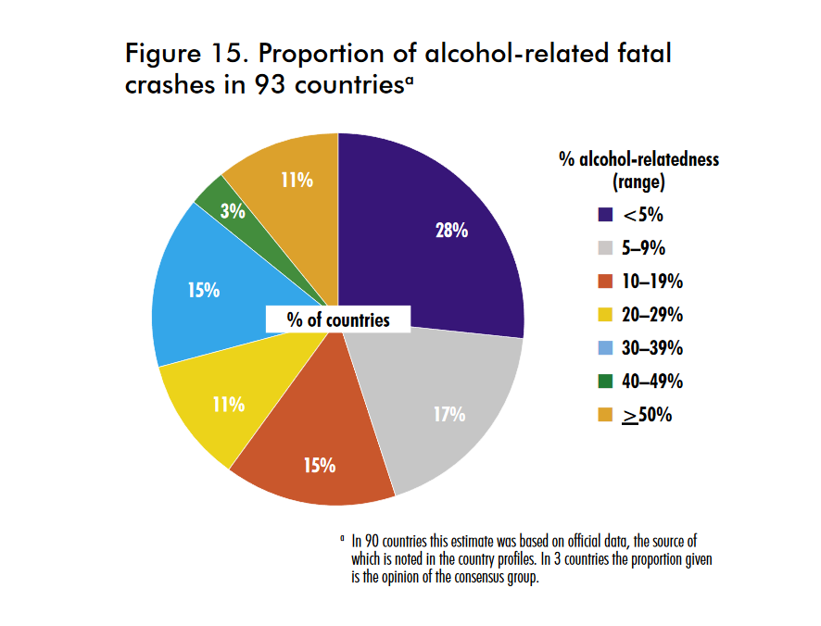
Pie chart
United Nations, GLOBAL STATUS REPORT ON ROAD SAFETY: TIME FOR ACTION (2008)

Slide 182
Histogram

Slide 183
Scatterplot

Slide 184
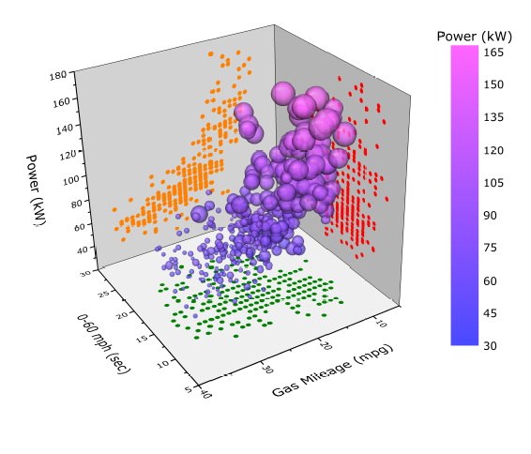
3-D Scatterplot
The Relationship between Speed, Power, and Gas Mileage in Cars

Slide 185
Activity #3
Compute descriptive statistics and a graphs of selected variable, compare weighted and unweighted data

Slide 187
SESRI
Policy & Program Evaluation Workshop
Doha, Qatar
January 19-22, 2015

Slide 188
Outline: Session 7
Analyzing survey data
  Simple relationships
    Correlation
    T-test
    Bivariate regression
  Complex relationships
    Multiple regression
  Activity #4: Statistical Relationships

Slide 189
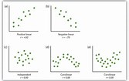
Correlation
Measure of the dependency of two variables

Slide 190
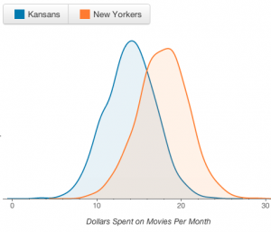
T-test (difference of means)
Tests whether the means of two samples are statistically different

Slide 191
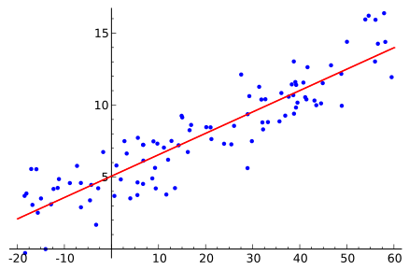
Regression
Estimating relationships among variables

Slide 192
Multiple Regression
Testing relationships among variables while controlling for other factors.
Example

Slide 193
Activity #4
Test hypotheses about the effect of a policy intervention on attitudes towards the causes of traffic accidents using bivariate and multivariate statistical models.

Slide 194
Concluding Comments

